Slide 1
Notes:
Hi I am

Slide 2
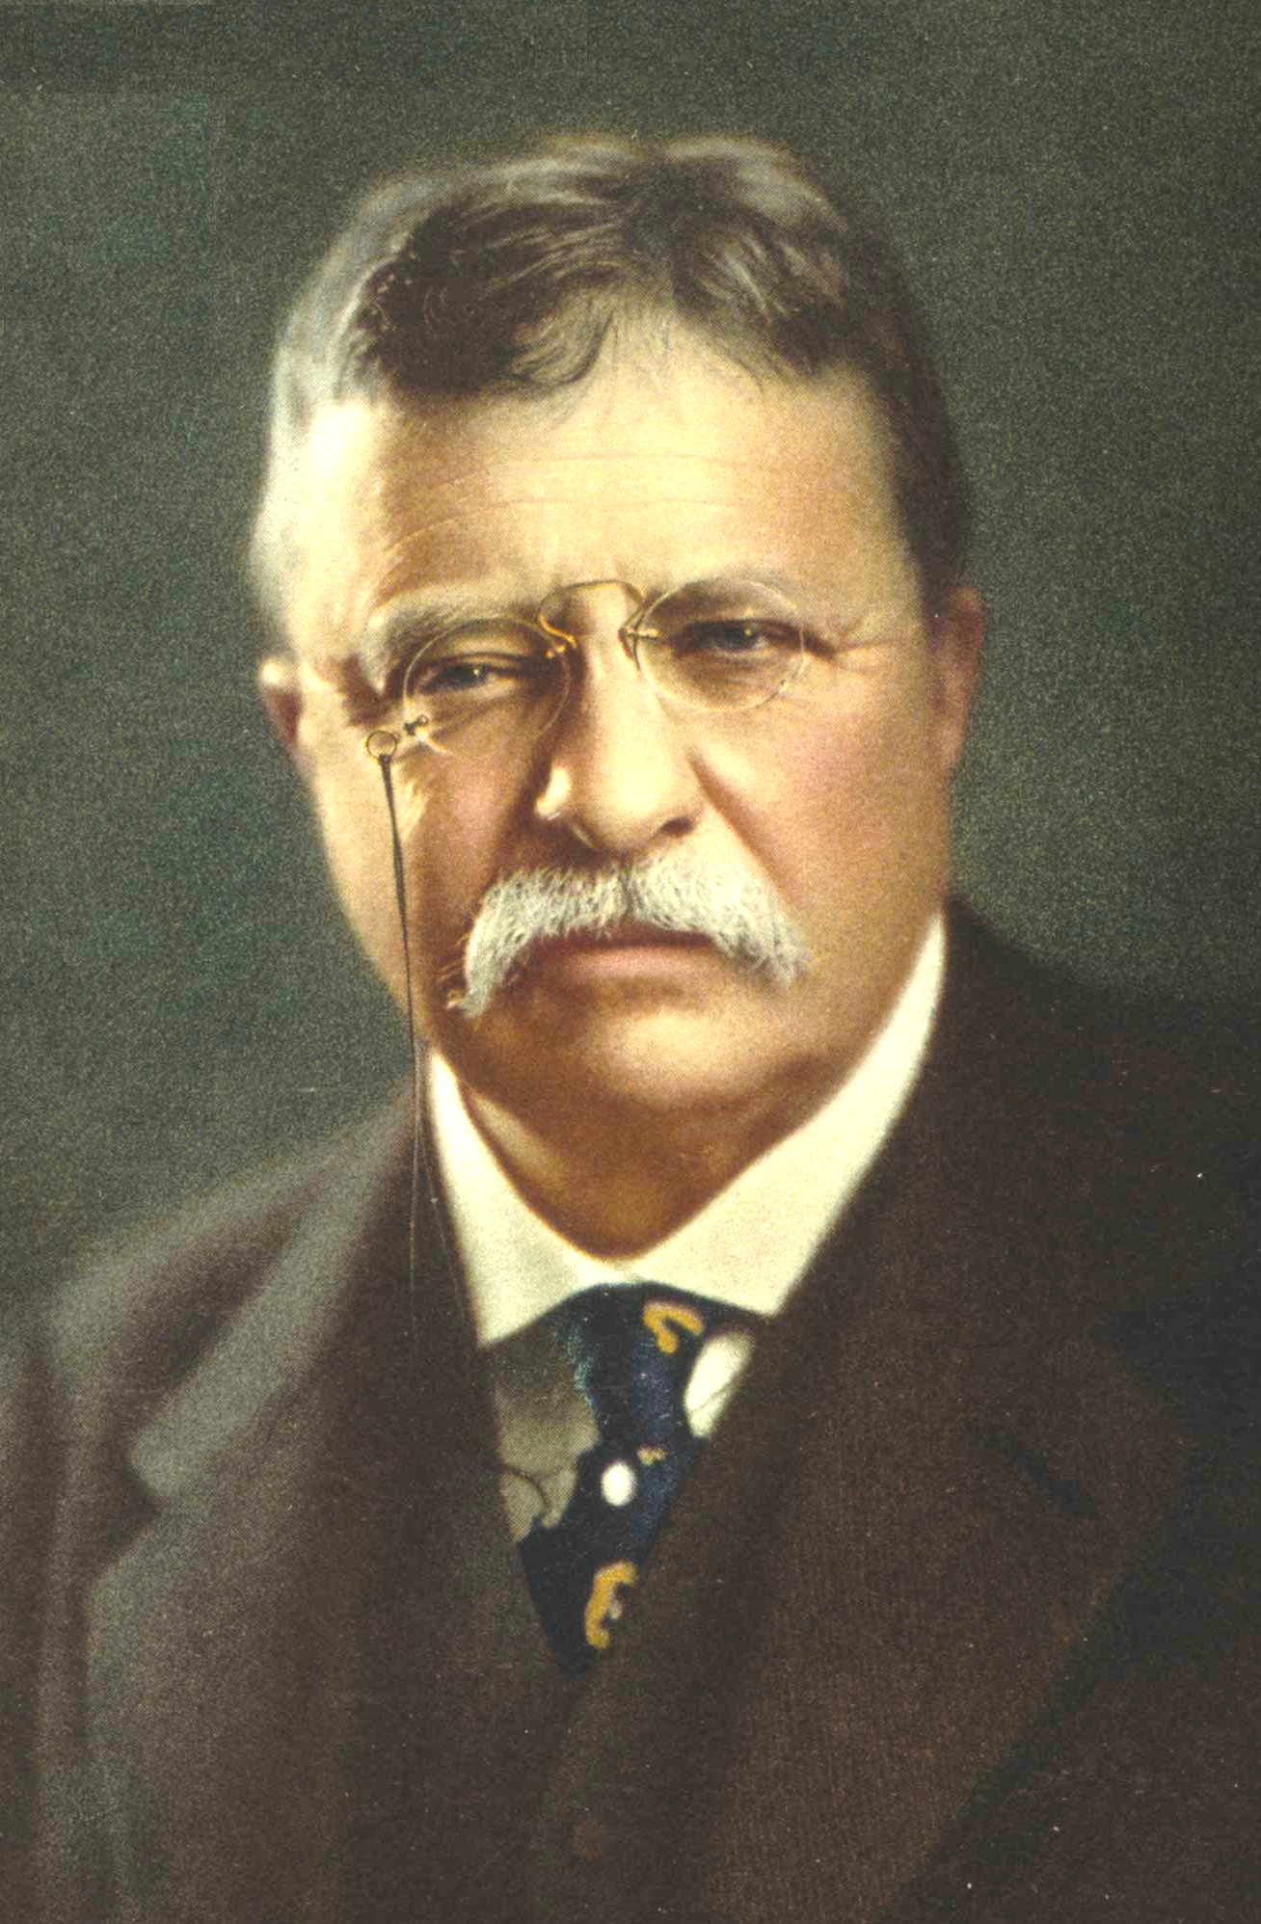
"Character, in the long run, is the decisive factor in the life of an individual and of nations alike."
Theodore Roosevelt
1858 –1919)
President of the United States
Theodore Roosevelt
26th President of the United States
Notes:
Character can be defined as doing the right thing; even when nobody is watching.
Integrity and character might be summarized as being reliable, honest, and dependable, having the courage to do the right thing, and being loyal to those who depend upon you.
We may not know how the character develops, but we know that changing a character takes time. I know of no reported cases of sudden onset of nature. A person's observable behavior indicates their character; what you see is what you get. A person with solid character shows drive, energy, determination, self-discipline, willpower, and nerve.

Slide 3
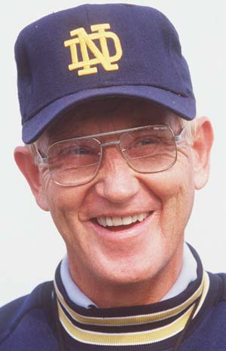
I follow three rules: Do the right thing, do the best you can, and always show people you care.
Lou Holtz
Notes:
One of my favorite stories regarding ethics involves a young and aggressive college football coach who dreams of becoming the head coach at the University of Notre Dame. He found himself and his University of Arkansas team about to play in a major post-season bowl game. He faced an ethical dilemma involving three players who broke the team rules. These three players had scored 78 of every 100 points during the regular season. Despite their transgressions, the press and alumni were screaming for the pragmatic answer to play them. But his belief system said they should not play in the big game.
The coach was steadied by a powerful sense of what was right; he benched the three players and won the 1978 Orange Bowl game with a stunning 31-6 upset over second-ranked Oklahoma. That victory left Arkansas third in both final polls.
Several years later, Father Theodore Hesburgh, the President of Notre Dame, offered Lou Holtz that head coaching job at Notre Dame. When he made the offer, he said the decision that Holtz would be the next head coach at Notre Dame was made the day of the 1978 Orange Bowl game.
It is often said that character is what you do when nobody is watching. That definition may be accurate, but it cannot be applied to ethics as a strategy for leadership. Character and ethics are what you do when everyone is watching. It is doing, and getting others to do, the right thing. That is why they will follow you.

Slide 4
“Formula for success: under promise and over deliver.”
Tom Peters
Famed Management Consultant

Slide 5
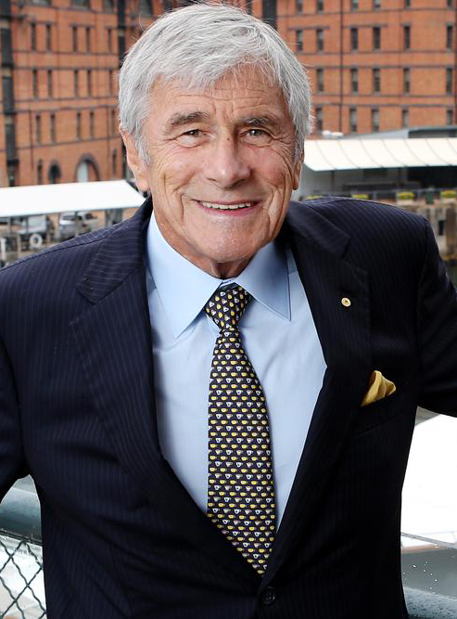
“Ethics or simple honesty is the building block upon which our whole society is based, and business is a part of our society, and it's integral to being able to conduct business that you have a set of moral standards. And it's much easier to do business with someone when you look them in the eye and say, ‘This is what we're going to do,’ and you understand what you each mean, and you can go away and get it done.”
Kerry Stokes
Australian Businessman
Notes:
The excuse for compromising ethical standards is always one of being pragmatic.
What matters is what you produce. What matters to people differs from how great you make your product sound. You can only sell people how great you are if you can demonstrate your competence with actual results. If you need to explain, you probably did not deliver.
Think about the people you know who have made agreements with you, and they come through repeatedly with no excuses made. For example, if I am on time every time I meet you, this builds trust with you. So much so that if I am late, you will believe something is wrong and check in with me, knowing it is an anomaly. But if I am frequently late, often explaining how hard I “tried,” and I continue promising that I will surely be on time next time, you will not trust me to be on time, nor will you trust what I say. And when I am late, you will go about your business without thinking anything is wrong because you have assessed me based on my performance, not my promise. This is how we learn and evaluate, based on results, not contracts.
If you need to use many words to convince a person because they should believe you will deliver on a promise, you have a low level of trust with that person.
Keep in mind that an inflated promise is an inflated contempt.

Slide 6
Notes:
Worthy topic

Slide 7
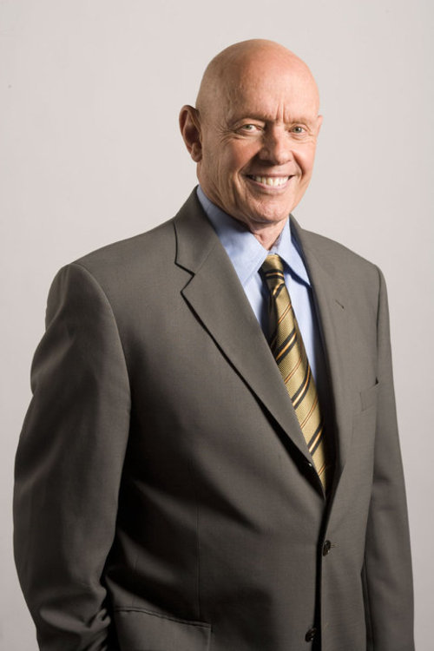
“Moral authority comes from following universal and timeless principles like honesty, integrity, treating people with respect.”
Stephen Covey

Slide 8
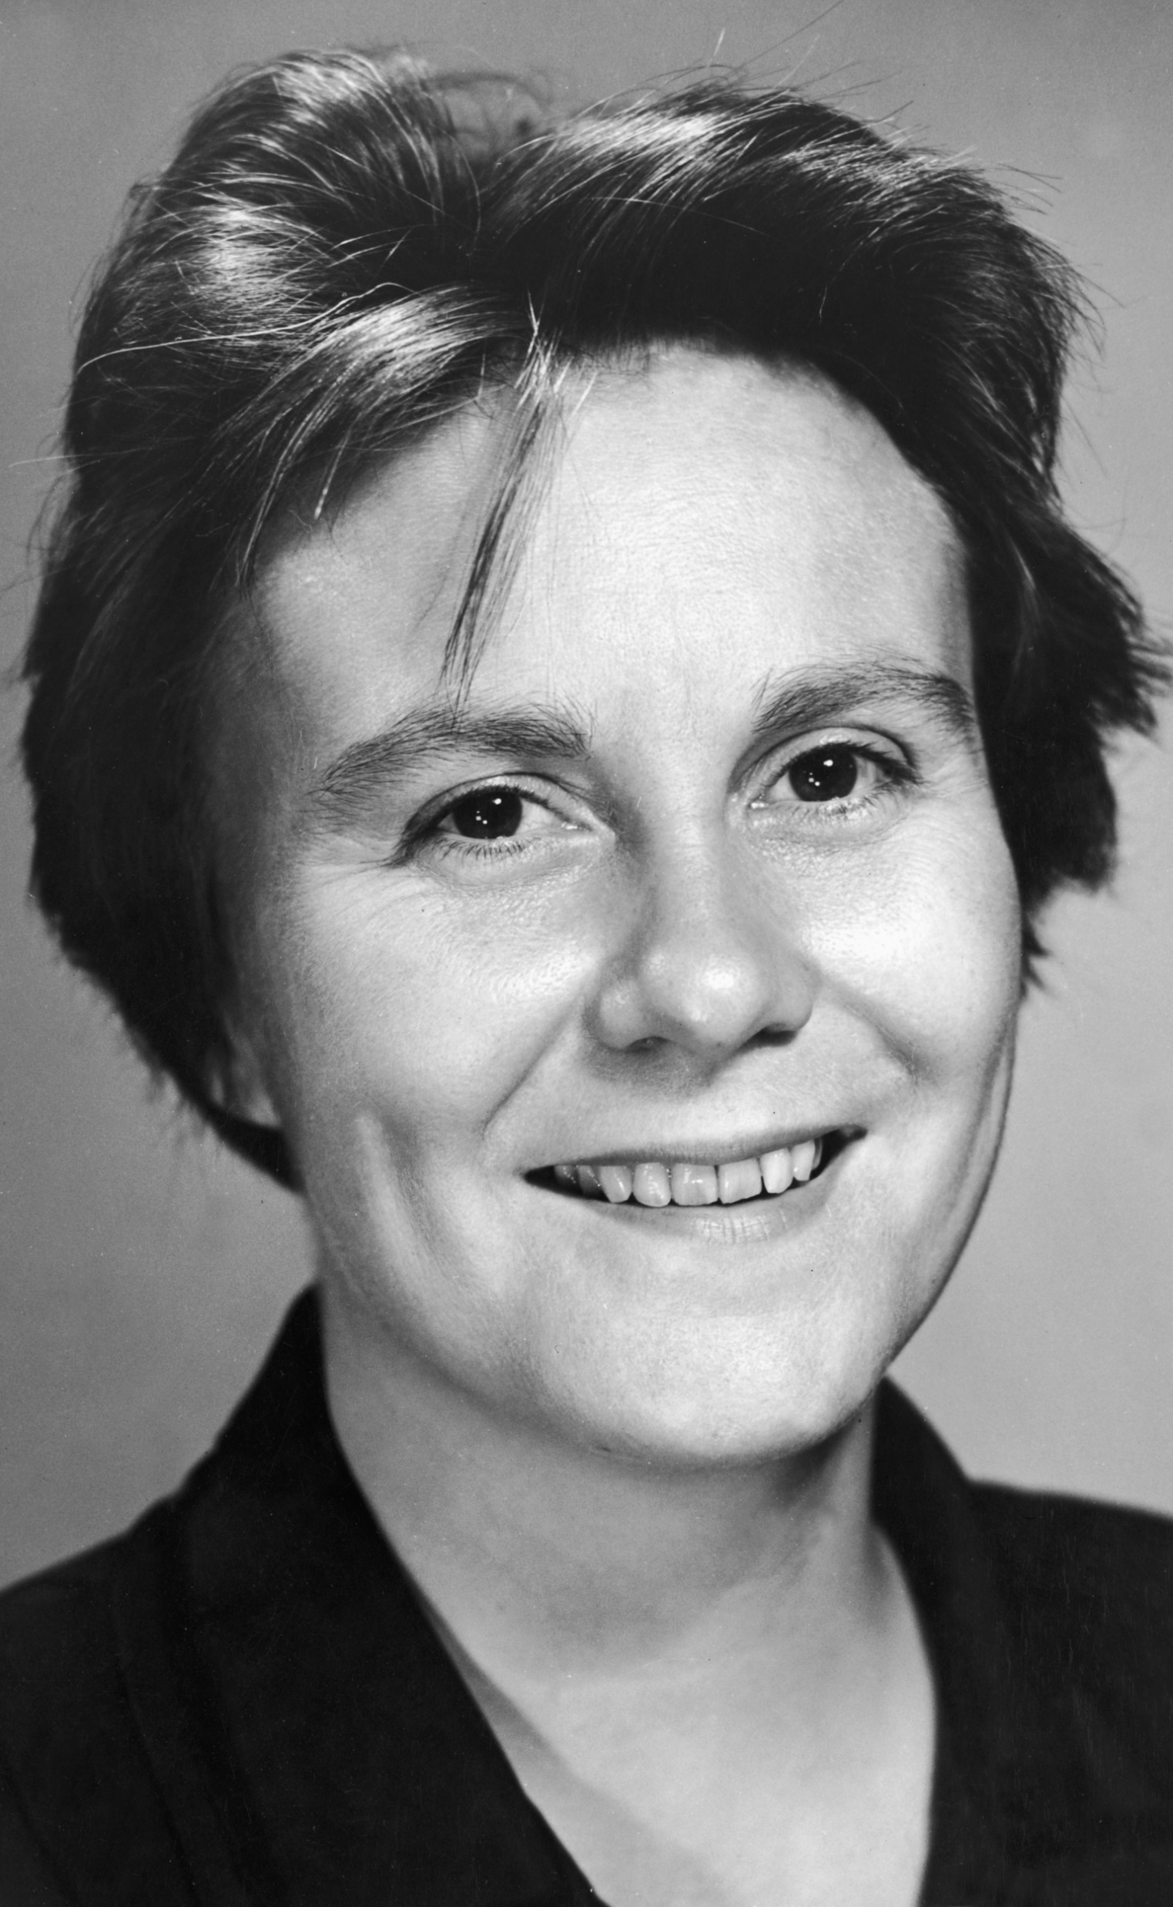
“They’re certainly entitled to think that, and they’re entitled to full respect for their opinions… but before I can live with other folks I’ve got to live with myself. The one thing that doesn’t abide by majority rule is a person’s conscience.”
Harper Lee
Author To Kill a Mockingbird

Slide 9
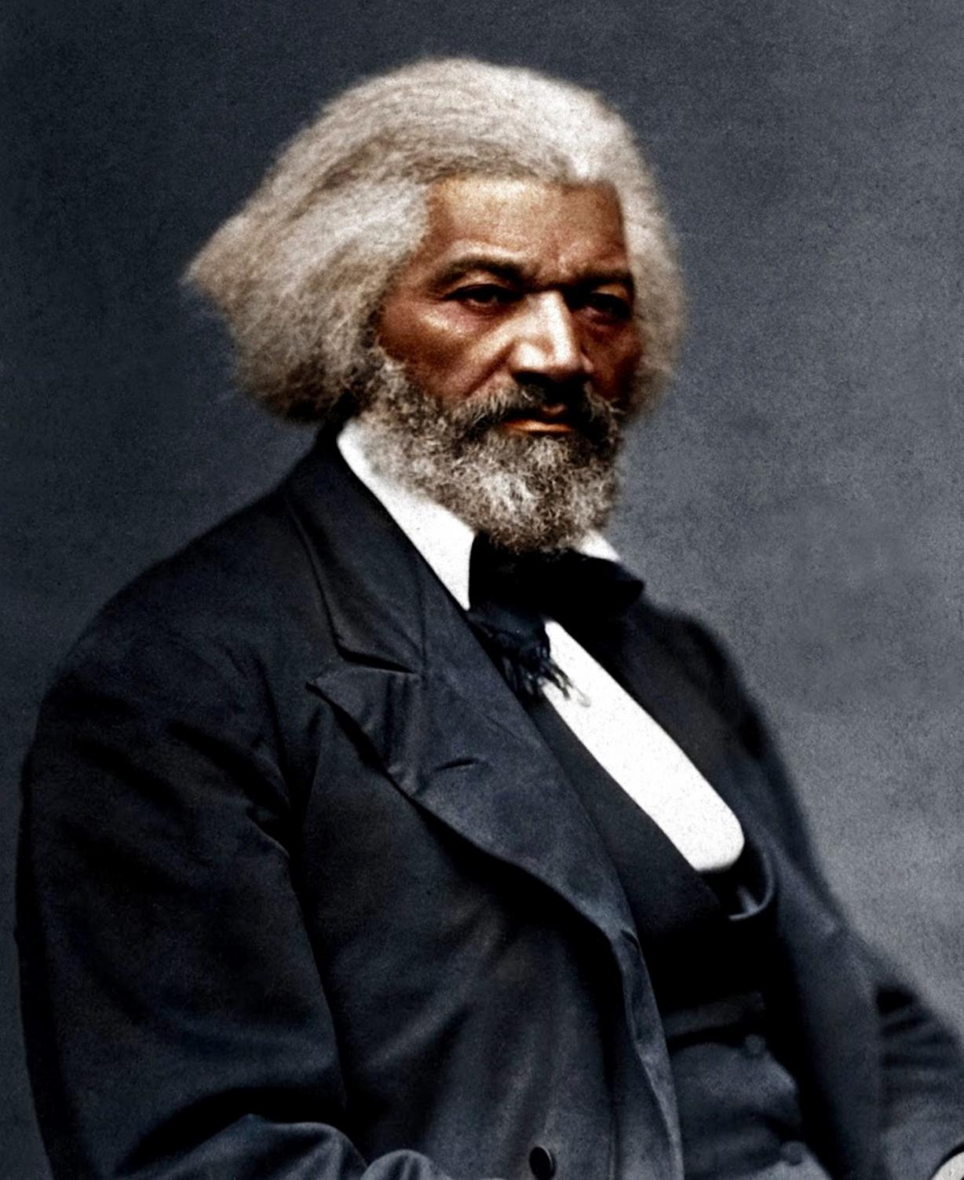
“I prefer to be true to myself, even at the hazard of incurring the ridicule of others, rather than to be false, and to incur my own abhorrence.”
Fredrick Douglas
American social reformer, abolitionist, orator, writer, and statesman

Slide 10
Integrity
Notes:
is the practice of being honest and showing a consistent and uncompromising adherence to strong moral and ethical principles and values. In ethics, integrity is regarded as the honesty and truthfulness or accuracy of one's actions. Integrity can stand in opposition to hypocrisy, in that judging with the standards of integrity involves regarding internal consistency as a virtue and suggests that parties holding within themselves conflicting values should account for the discrepancy or alter their beliefs. The word integrity evolved from the Latin adjective integer, meaning whole or complete. In this context, integrity is the inner sense of "wholeness" deriving from qualities such as honesty and consistency of character.In ethics, an individual is said to possess the virtue of integrity if the individual's actions are based upon an internally consistent framework of principles.^{[6][7]} These principles should uniformly adhere to sound logical axioms or postulates. One can describe a person as having ethical integrity to the extent that the individual's actions, beliefs, methods, measures, and principles all derive from a single core group of values. An individual must, therefore, be flexible and willing to adjust these values to maintain consistency when these values are challenged—such as when an expected test result is not congruent with all observed outcomes. Because such flexibility is a form of accountability, it is regarded as a moral responsibility as well as a virtue.
An individual value system provides a framework within which the individual acts in ways that are consistent and expected. Integrity can be seen as the state or condition of having such a framework and acting congruently within the given framework.
One essential aspect of a consistent framework is its avoidance of any unwarranted (arbitrary) exceptions for a particular person or group—especially the person or group that holds the framework. In law, this principle of universal application requires that even those in positions of official power can be subjected to the same laws as pertain to their fellow citizens. In personal ethics, this principle requires that one should not act according to any rule that one would not wish to see universally followed. For example, one should not steal unless one would want to live in a world in which everyone was a thief. The philosopher Immanuel Kant formally described the principle of universal application in his categorical imperative.
The concept of integrity implies a wholeness, a comprehensive corpus of beliefs often referred to as a worldview. This concept of wholeness emphasizes honesty and authenticity, requiring that one act at all times in accordance with the individual's chosen worldview.

Slide 11
What are the 5 attributes of integrity?
Integrity is both a personality trait and a skill, meaning you can develop this over time. Here are attributes that contribute to being a person with integrity and how you can display these traits:
Notes:
is the practice of being honest and showing a consistent and uncompromising adherence to strong moral and ethical principles and values. In ethics, integrity is regarded as the honesty and truthfulness or accuracy of one's actions. Integrity can stand in opposition to hypocrisy, in that judging with the standards of integrity involves regarding internal consistency as a virtue and suggests that parties holding within themselves conflicting values should account for the discrepancy or alter their beliefs. The word integrity evolved from the Latin adjective integer, meaning whole or complete. In this context, integrity is the inner sense of "wholeness" deriving from qualities such as honesty and consistency of character.

Slide 12
What are the 5 attributes of integrity?
Integrity is both a personality trait and a skill, meaning you can develop this over time. Here are attributes that contribute to being a person with integrity and how you can display these traits:
Dependability
Notes:
Dependability means people can rely on you and that you keep promises. You're able to commit to tasks, people and events in which you can take part. Employers can trust you and give you more responsibilities. Your colleagues are happy to collaborate with you because they can rely on you to complete your share of a project.
To develop skills to be dependable, ensure that you meet deadlines, do what you say and are punctual. Assisting your colleagues is also a good way to show you're dependable

Slide 13
Loyalty
Notes:
2. Loyalty
Employers especially value and appreciate the loyalty of their employees. You can show loyalty by committing yourself to the company where you work and helping them to achieve their goals. You can be loyal to your team members by speaking kindly of them and assisting them when they need help.
Listening to authority and respecting their decisions is another way to show loyalty. It's also important to protect trade secrets such as company processes, inventions or strategies.

Slide 14
Honesty
Notes:
3. Honesty
Integrity requires honesty. Those with integrity strive to be truthful. They own up to mistakes and try to learn from them. This attribute also means being authentic in the workplace.
Being honest encourages others to trust you and helps build meaning full relationships. Your colleagues are more likely to enjoy working with you, and this can create a positive work environment. You may also increase your career opportunities by handling professional matters with honesty.

Slide 15
Good judgement
Notes:
4. Good judgement
Integrity requires some critical thinking and assessment skills to determine the best choice in decision-making situations. Showing integrity can help you develop a keen sense of intuition and make good judgements more consistently. Ensure that you carefully consider your options in a situation and try to predict the outcomes of each choice. If your decision affects your colleagues, it's important to decide with them in mind.
Possessing the other attributes of integrity is indicative that you're an individual with good judgement. You make decisions and act in a way that encourages others to trust, respect and depend on you.

Slide 16
Respect
Notes:
Respect
People with integrity value other people by showing them respect at work. They do their best to be on time for meetings, meet project deadlines and keep others' feelings in mind. You can demonstrate this trait by exercising punctuality, care with your words and careful consideration of people's ideas. Developing interpersonal skills can help you be more aware of others' feelings and empathise.

Slide 17
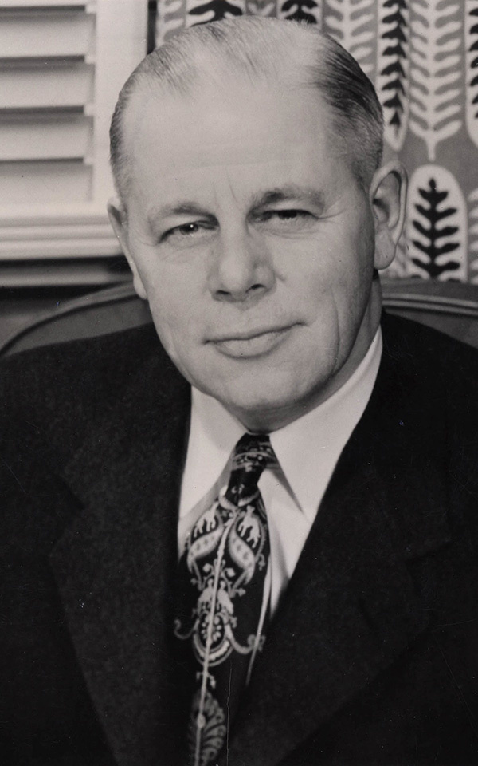
Herbert J. Taylor
President
Club Aluminum Company
Notes:
This chapter assesses the life and career of Herbert J. Taylor, the president of Club Aluminum Company. A devout Methodist who believed that God called laymen as well as clergy to Christianize the world, Taylor devised a system of philanthropy through which he could change his society and nudge his nation back to God. With twenty-five percent of Club Aluminum stock, he created the nonprofit Christian Workers Foundation, which would fund several evangelical enterprises. In order to align, in principle and statement, his faith to his business, and demonstrate to the world what businessmen could do for God, he devised the “Four-Way Test.” A statement of core values according to which he pledged to run his business, the Test also served as a tool for evangelizing and unifying Christian businessmen around a sense of higher calling, and legitimating business practices as fair and Godly. In both his business and his philanthropic outreach Taylor sought to bring conservative Protestantism into the public sphere and map out a future for the nation in which evangelical leaders cut from the corporate mold could incite widespread revival

Slide 18
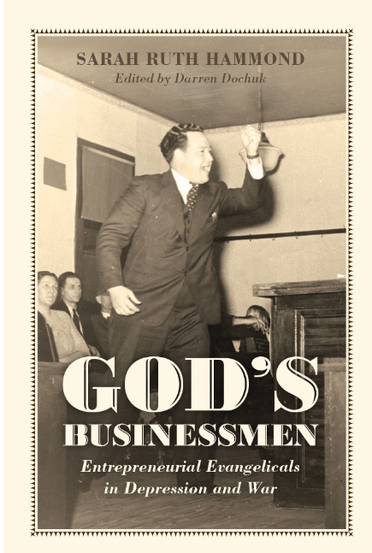
God's Businessmen: Entrepreneurial Evangelicals in Depression and War
Notes:
God’s Businessmen: Entrepreneurial Evangelicals in Depression and War chronicles the lives, businesses, and ministries of several Christian corporate leaders, whose religious and political activism between the 1920s and 1940s laid the foundations of the modern religious right. Challenging prevailing scholarly opinion that evangelicals—“fundamentalists,” as they were known then—remained apolitical and otherworldly in the Interwar period, this book carefully outlines how Christian businessmen such as R.G. LeTourneau and Herbert J. Taylor, leading figures in this account, grappled with the expanding federal state under the New Deal and during World War II. While on their factory floors and in their boardrooms they folded evangelical principles into manufacturing and managerial strategies, in their church spheres they financed evangelical causes and pushed clergy to tap laymen’s proselytizing energy. At the same time, they brought their conservative theology to bear on critical political issues such as taxation, government regulation, labor unions and workers rights, and the challenge, as they saw it, to uphold private enterprise against “big government” and the spread of socialist and communist subversion. The ideas and institutions they advanced in this political moment served as a base from which post-World War II religious and political conservatives would spread their gospel.

Slide 19
“It is true that integrity alone won’t make you a leader, but without integrity you will never be one.”
“Don’t ever promise more than you can deliver, but always deliver more than you promise.”
Lou Holtz

Slide 20
Everybody wants to talk about their rights and privileges. Twenty-five years ago, people talked about their obligations and responsibilities.
Notre Dame Coach” ― Lou Holtz
Lou Holtz
Notes:
One of my favorite stories regarding ethics involves a young and aggressive college football coach who had a dream of becoming the head coach at Notre Dame.
He found himself, and his team, In his first season at Arkansas about to play the biggest in a the 1978 Orange Bowl game when his team's top two running backs Ben Cowins and Donny Bobo violated his rules and he was forced to for the Orange Bowl, for disciplinary reasons. However, the Hogs defeated the Sooners, 31–6.
That victory left Arkansas third in both of the final polls and Holtz was named National Coach of the Year by the Football Writers Association of America and the Walter Camp Foundation.
Several years later, Father Hesburgh offered Lou Holtz the head coaching job at Notre Dame. When he made the offer, he said the decision that Holtz would be the next head coach at Notre Dame was made the day of the 1978 Orange Bowl game.
Along the way, he attained the singular distinction of having two of his Notre Dame teams achieve the nation's highest graduation rates among college athletes.
The story about Lou Holtz is only one of many that reinforce the idea of ethics as an anchor that creates a foundation for success. It is often said that character is what you do when nobody is watching. That definition may be true, but it cannot be applied to ethics as a strategy for leadership. Character and ethics are what you do when everyone

Slide 21
Notes:
More than 60 years ago, in the midst of the Great Depression, a U.S. Rotarian devised a simple, four-part ethical guideline that helped him rescue a beleaguered business. The statement and the principles it embodied also helped many others find their own ethical compass. Soon embraced and popularized by Rotary International, The Four-Way Test today stands as one of the organization’s hallmarks. It may very well be one of the most famous statements of our century.
Herbert J. Taylor, author of the Test, was a mover, a doer, a consummate salesman and a leader of men. He was a man of action, faith and high moral principle. Born in Michigan, USA, in 1893, he worked his way through Northwestern University in Evanston, Illinois.
After graduation, Herb went to France on a mission for the YMCA and the British Army welfare service and served in the U.S. Navy Supply Corps in World War I. In 1919, he married Gloria Forbrich, and the couple set up housekeeping in Oklahoma, USA, where he worked for the Sinclair Oil Company. After a year, he resigned and went into insurance, real estate and oil lease brokerage.
With some prosperous years behind him, Herb returned to Chicago, Illinois, in 1925 and began a swift rise within the Jewel Tea Company. He soon joined the Rotary Club of Chicago. In line for the presidency of Jewel in 1932, Herb was asked to help revive the near-bankrupt Club Aluminum Company of Chicago. The cookware manufacturing company owed $400,000 more than its total assets and was barely staying afloat. Herb responded to the challenge and decided to cast his lot with this troubled firm. He resigned from Jewel Tea, taking an 80 percent pay cut to become president of Club Aluminum. He even invested $6,100 of his own money in the company to give it some operating capital.
Looking for a way to resuscitate the company and caught in the Depression’s doldrums, Herb, deeply religious, prayed for inspiration to craft a short measuring stick of ethics for the staff to use.

Slide 22
Notes:
About the 4-Way Test
Rate this (66 Votes)
As he thought about an ethical guideline for the company, he first wrote a statement of about 100 words but decided that it was too long. He continued to work, reducing it to seven points. In fact, The Four-Way Test was once a Seven-Way Test. It was still too long, and he finally reduced it to the four searching questions that comprise the Test today.
Next, he checked the statement with his four department heads: a Roman Catholic, a Christian Scientist, an Orthodox Jew and a Presbyterian. They all agreed that the Test’s principles not only coincided with their religious beliefs, but also provided an exemplary guide for personal and business life.
And so, “The Four-Way Test of the things we think, say or do” was born:
1. Is it the TRUTH? 2. Is it FAIR to all Concerned? 3. Will it build GOODWILL and BETTER FRIENDSHIPS? 4. Will it be BENEFICIAL to all concerned?
Profound in its simplicity, the Test became the basis for decisions large and small at Club Aluminum.
But any test must be put to the test. Would it work in the real world? Could people in business really live by its precepts? One lawyer told Herb: “If I followed the Test explicitly, I would starve to death. Where business is concerned, I think The Four-Way Test is absolutely impractical.”
The attorney’s concerns were understandable. Any ethical system that calls for living the truth and measuring actions on the basis of benefits to others is demanding. Such a test can stir bitter conflict for those who try to balance integrity and ambition. Sizzling debates have been held in various parts of the world on its practicality as a way of living. There are always some serious-minded Rotarians, not to mention skeptics and negative thinkers, who view The Four-Way Test as a simplistic philosophy of dubious worth, contradictory meaning and unrealistic aims. The Test calls for thoughtful examination of one’s motives and goals. This emphasis on truth, fairness and consideration provide a moral diet so rich that it gives some people “ethical indigestion.”
But at Club Aluminum in the 1930s, everything was measured against The Four-Way Test. First, the staff applied it to advertising. Words like “better,” “best,” “greatest” or “finest” were dropped from ads and replaced by factual descriptions of the product. Negative comments about competitors were removed from advertising and company literature.
The Test gradually became a guide for every aspect of the business, creating a climate of trust and goodwill among dealers, customers and employees. It became part of the corporate culture, and eventually helped improve Club Aluminum’s reputation and finances.
One day, the sales manager announced a possible order for 50,000 utensils. Sales were low and the company was still struggling at the bankruptcy level. The senior managers certainly needed and wanted that sale, but there was a hitch. The sales manager learned that the potential customer intended to sell the products at cut-rate prices. “That wouldn’t be fair to our regular dealers who have been advertising and promoting our product consistently,” he said. In one of the toughest decisions the company made that year, the order was turned down. There was no question this transaction would have made a mockery out of The Four-Way Test the company professed to live by.
By 1937, Club Aluminum’s indebtedness was paid off and during the next 15 years, the firm distributed more than $1 million in dividends to its stockholders. Its net worth climbed to more than $2 million.
Too idealistic for the real world? The Four-Way Test was born in the rough and tumble world of business, and put to the acid test of experience in one of the toughest times that the business community has ever known. It survived in the arena of practical commerce.
In 1942, Richard Vernor of Chicago, then a director of Rotary International, suggested that Rotary adopt the Test. The R.I. Board approved his proposal in January 1943 and made The Four-Way Test a component of the Vocational Service program, although today it is considered a vital element in all four Avenues of Service.
Herb Taylor transferred the copyright to Rotary International when he served as R.I. president in 1954-55, during the organization’s golden anniversary.
Today, more than six decades since its creation, has the Test lost its usefulness in modern society, as some critics maintain? Is it sophisticated enough to guide business and professional men and women in these fast-paced times?
Is it the TRUTH? There is a timelessness in truth that is unchangeable. Truth cannot exist without justice.
Is it FAIR to all concerned? The substitution of fairness for the harsh principles of doing business at arm’s length has improved rather than hurt business relationships.
Will it build GOODWILL and BETTER FRIENDSHIPS? Man is by nature a cooperative creature and it is his natural instinct to express love.
Will it be BENEFICIAL to all concerned? This question eliminates the dog-eat-dog principle of ruthless competition and substitutes the idea of constructive and creative competition.
The Four-Way Test is international, transcending national boundaries and language barriers. It knows no politics, dogma or creed. More than a code of ethics, it has all the ingredients for a successful life in every way. It can and will work in today’s society.
The final test is in the doing. William James, the noted psychologist, once said, “The ultimate test of what a truth means is the conduct it dictates or inspires.” At the heart of Rotary today is The Four-Way Test, a call to moral excellence. Human beings can grow together. Modern business can be honest and trustworthy. People can learn to believe in one another. At the 1977 R.I. Convention, James S. Fish of the U.S. Better Business Bureaus said, “To endure, the competitive enterprise system must be practiced within the framework of a strict moral code. Indeed, the whole fabric of the capitalistic system rests to a large degree on trust . . . on the confidence that businessmen and women will deal fairly and honestly, not only with each other, but also with the general public, with the consumer, the stockholder and the employee.”
Few things are needed more in our society than moral integrity. The Four-Way Test will guide those who dare to use it for worthy objectives: choosing, winning, and keeping friends; getting along well with others; ensuring a happy home life; developing high ethical and moral standards; becoming successful in a chosen business or profession; and becoming a better citizen and better example for the next generation.
Eloquently simple, stunning in its power, undeniable in its results, The Four-Way Test offers a fresh and positive vision in the midst of a world full of tension, confusion and uncertainty.

Slide 23
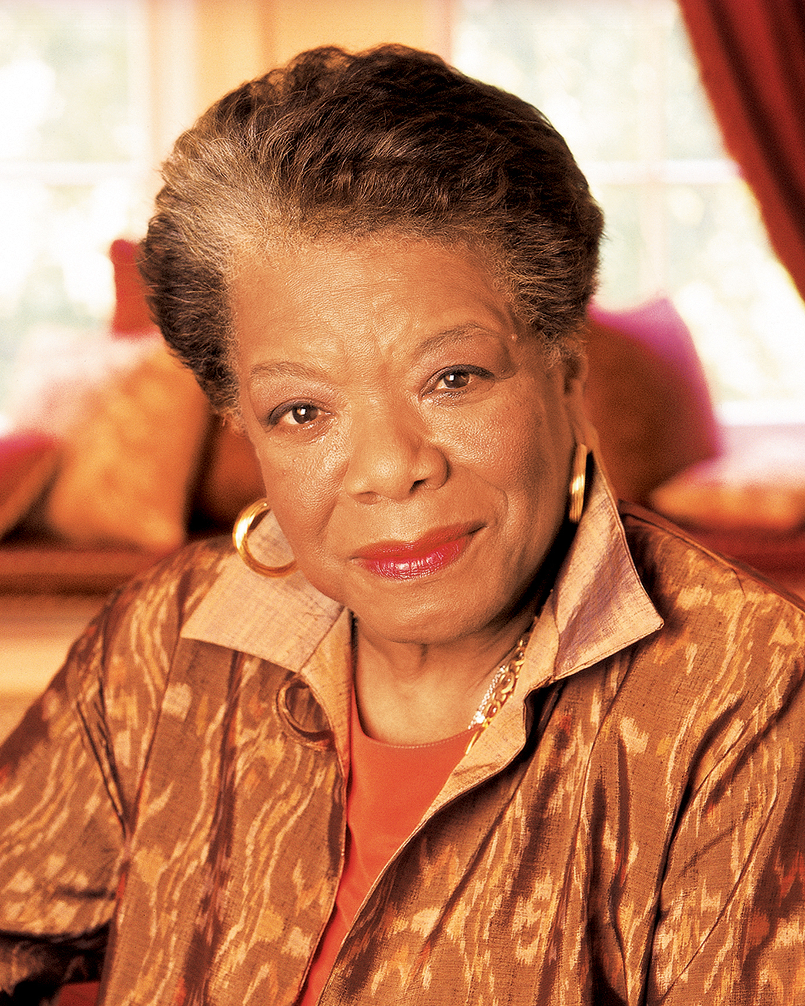
“I’ve learned that people will forget what you said, people will forget what you did, but people will never forget how you made them feel.”
Maya Angelou

Slide 24
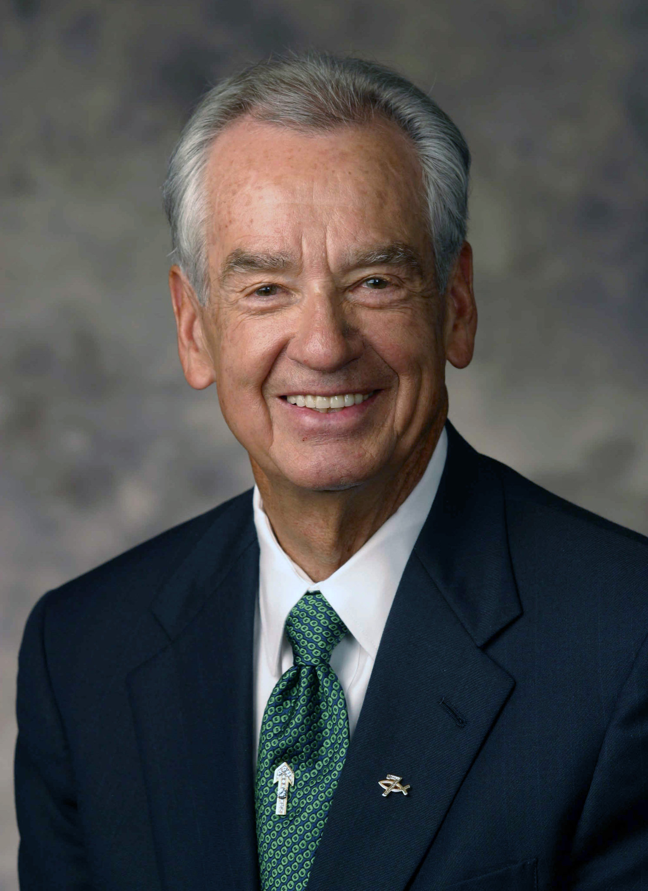
The foundation stones for a balanced success are honesty, character, integrity, faith, love and loyalty.”
Zig Ziglar

