Slide 1
Notes:
The first and lasting impression is that the extraordinarily successful have the ‘gift of gab’ and can eventually talk anyone into submission.
That first impression is wrong.
The extraordinarily successful leaders simply have extraordinary communication skills - skills that allow them to gather information while listening to those people they intend to lead

Slide 2
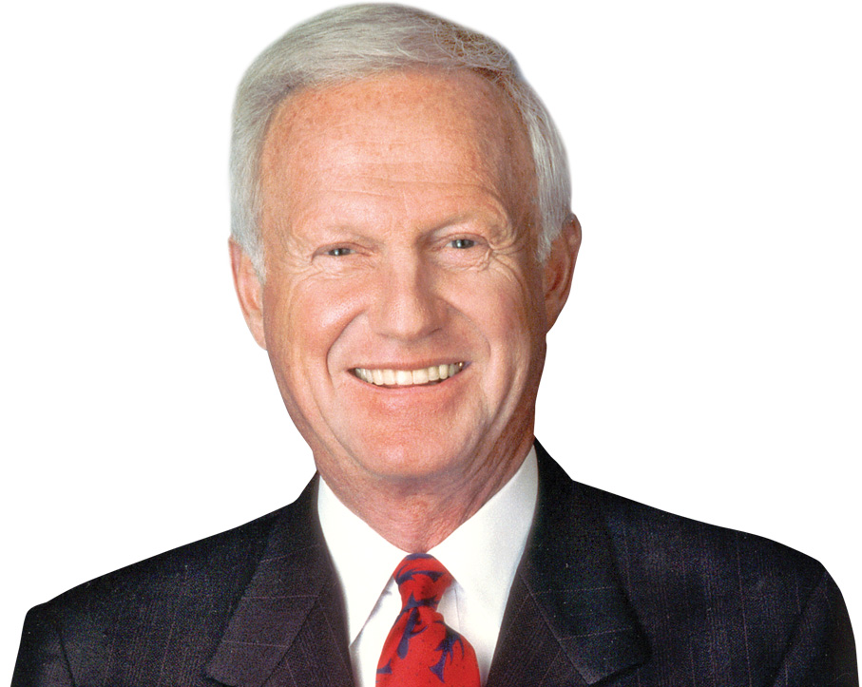
"You learn when you listen. You earn when you listen; not just money, but respect."
Harvey Mackay
Author and Motivational Speaker
Notes:
"You learn when you listen. You earn when you listen; not just money, but respect."
Harvey Mackay
Author and Motivational Speaker.
The old axiom that nobody cares how much you know; until they know how much you care makes as much sense today as it ever did. You earn respect from others for your thoughts and opinions by showing interest and concern for their views.

Slide 3
“I never learned anything while I was talking.”
Lou Holtz
Famed Football Coach
Notes:
You cannot be a great leader unless you know where you’re going. And you can’t you great leader as you know where you are to start.
Famed football coach Lou Holtz said, “I never learned anything while I was talking.”
Prescription without diagnosis is malpractice; no matter what the context.

Slide 4
Notes:
Communication involves several different skills including speaking, writing, reading and listening.
Two of those skills are expressive skills that allow the skilled users to express their ideas.
As a demonstration of their importance, reading, writing and speaking are all central skills required of every high school student.
Our educators either don’t weigh the skills of listening as high of a priority or they simply don’t know how to teach this skill.
Not so surprisingly most teenagers are able to completely avoid the use of almost all forms of communications.
It is evident from nature that God gave each of us two ears and only one mouth. Evidently, she thought listening was twice as important as talking.

Slide 5
Notes:
Imagine with me that we are all traveling at 500 mph at an altitude of 30,000 feet in an airplane built by the lowest bidder.
Before take off you received that mandatory safety briefing and probably managed with as little pain as possible to endure the message.
Later in the flight you hear across the intercom this message,
"Ladies and gentlemen this is your captain speaking. In about five minutes we are going to make an emergency landing. If you listen carefully to the instructions I am about to give there will be no injuries or deaths.“
You are about to exercise those listening skills more effectively than ever before.

Slide 6
"A good listener tries to understand what the other person is saying. In the end he may disagree sharply, but because he disagrees, he wants to know exactly what it is he is disagreeing with."
Kenneth A. Wells
Journalist and Novelist
Notes:
"A good listener tries to understand what the other person is saying. In the end he may disagree sharply, but because he disagrees, he wants to know exactly what it is he is disagreeing with."
Kenneth A. Wells
Journalist and Novelist
The first part of listening is simply comprehension. That part of listening can be translated to mean accurately identifying speech sounds and understanding those sounds as words. We are constantly bombarded with noise, so the listener has to select which of those sounds is actually speech and pay attention to the appropriate sounds.
Then you have to break those sounds into words. This may seem to be an over simplification unless you try it in an unfamiliar language where the speech sounds blend together into a continuous cluster.

Slide 7
Comprehending,
Retaining,
Responding.
Notes:
Listening can be more than simply being quiet while the other person rambles.
Active listening is a structured way of listening and responding to others, focusing attention on the speaker. Suspending one's own frame of reference, suspending judgment and avoiding other internal mental activities are important to fully attend to the speaker.
Active listening can be broken down to three primary elements that comprise active listening: comprehending, retaining, and responding.
Listening is the tool that enables you, the leader or sales professional, to know where you should be leading to or what you should be selling. Listening is the skill that allows the leader to define the common vision and the common vision defines the goals or destination.

Slide 8
"Seek first to understand, then to be understood."
Stephen R. Covey 7 Habits of Highly Effective People
Notes:
Seeking first to understand before being understood isn’t about who’s right or wrong; it is a philosophy of effective communication. When you practice this method, you’ll notice that the people you communicate with will feel listened to, heard, and understood. This will translate into better, more loving relationship
Memory is essential to the listening process because the information we retain when listening is how we create meaning from words. Because everyone has different memories, the speaker and the listener may attach different meanings to the same statement. On the other hand, why bother listening in the first place if we aren’t going to remember what we heard?
Since our memories are fallible we don't always remember everything we've heard. Maybe we are trying to cram too much information from a conversation into the short-term memory box in our brain. That is something like a system overload and the result is nothing in the short-term memory bank to upload into the long-term memory.
There are many reasons why we forget some information that we've received. When you cram too much information into your short-term memory and the information isn’t needed anymore, it is purged from your brain before it can be transferred into your long-term memory.
Alternately, if you aren't paying attention to the information you receive you will attach little importance to it. Maybe you simply lacked motivation to listen carefully in the first place. Using information immediately after receiving it enhances information retention and lessens the forgetting curve. Retention is lessened when we engage in mindless listening, where little effort is made to listen to a speaker's message.
A useful strategy of listening is to make the effort of simplifying what you hear so that one or two words will trigger your memory of what was said. Coincidental with that strategy is simplifying complicated words into simple, memorable, words.

Slide 9
Impetuous celebrity engenders purposeless spoilage.
Haste makes waste.
Notes:
Proverb Simplification Exercise
Retaining what you hear is often a matter of simplifying what is said to make retention easier. Unfortunately, some people like to use big words to obfuscate what they want in the hope of impressing their listeners. Unfortunately, it seldom makes a positive impression.
Here are a few examples:
Impetuous celebrity engenders purposeless spoilage.
CLICK TO SEE > Haste makes waste

Slide 10
Illegal transgression has no remuneration for its perpetrators.
Crime does not pay.
Notes:
Illegal transgression has no remuneration for its perpetrators.
CLICK TO SEE > Crime does not pay.

Slide 11
A winged and feathered animal in the digital limb is as valuable as duet in the shrubbery.
A bird in the hand is worth two in the bush.
Notes:
A winged and feathered animal in the digital limb is as valuable as duet in the shrubbery.
CLICK TO SEE > A bird in the hand is worth two in the bush.

Slide 12
The warm-blooded class aves who is governed by promptitude can apprehend the small, elongated, and slender creeping animal.
The early bird gets the worm.
Notes:
The warm-blooded class aves who is governed by promptitude can apprehend the small, elongated, and slender creeping animal
CLICK TO SEE > The early bird gets the worm.

Slide 13
Provide the privilege of enfranchisement, or I will feel that life is not worth living.
Give me liberty or give me death.
Notes:
Provide the privilege of enfranchisement, or I will feel that life is not worth living.
CLICK TO SEE > Give me liberty or give me death.

Slide 14
A condition characterized by tardiness is more desirable than one that is systematically marked by eternal absenteeism.
Better late than never.
Notes:
A condition characterized by tardiness is more desirable than one that is systematically marked by eternal absenteeism.
CLiCK TO SEE > Better late than never.

Slide 15
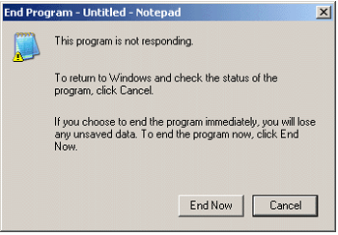
Notes:
Listening is an interaction where the listener is normally a passive participant. But the speaker is often looking for both verbal and nonverbal responses from the listener to confirm the message is being received. If the response is verbal the speaker and listener reverse roles and the listener becomes the speaker and is no longer listening.

Slide 16
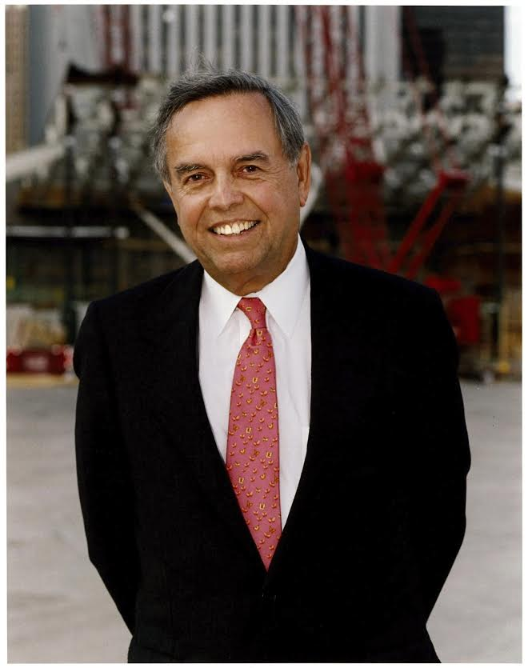
"You have to be willing sometimes to listen to some remarkable bad opinions. Because if you say to someone, 'That's the silliest thing I've ever heard; get on out of here!'—then you'll never get anything out of that person again, and you might as well have a puppet on a string or a robot."
John Bryan
Former CEO Sara Lee Corp.
Notes:
Responding and reacting seem like two words with identical meaning, unless you are talking about responding or reacting to that drug your doctor prescribed.
When individuals listen and hear something to which they don’t agree they often react with the effect of denying the validity of the other person's position.
I have personally adopted what I call the ’24 hour rule’ where I purposely wait 24 hours before confronting those few individuals who say something to which I don’t agree. The more vehemently I don’t agree the longer the 24 hour rule is extended for. Like wise, I may only invoke the 24 hour rule for a few minutes for small incursions into the ridiculous by the person I am listening to.

Slide 17
Prescription without diagnosis is malpractice;
no matter what the context.
Notes:
Providing leadership requires diagnosing where you are leading others.
Like a doctor who fails to listen to their patient Prescription without diagnosis is malpractice

Slide 18
Notes:
Listening is a basic skill that we all possess, but few of us are really good at utilizing it. That is why we are spending so much time and effort in discussing this important issue to both leadership and salesmanship.

Slide 19
Notes:
Here is a little video from yesteryear that demonstrates what happens when the speaker and the listener are inn different places and fail to understand each other
Memory is essential to the listening process because the information we retain when listening is how we create meaning from words. Because everyone has different memories, the speaker and the listener may attach different meanings to the same statement. On the other hand, why bother listening in the first place if we aren’t going to remember what we heard?
Since our memories are fallible we don't always remember everything we've heard. Maybe we are trying to cram too much information from a conversation into the short-term memory box in our brain. That is something like a system overload and the result is nothing in the short-term memory bank to upload into the long-term memory.
There are many reasons why we forget some information that we've received. When you cram too much information into your short-term memory and the information isn’t needed anymore, it is purged from your brain before it can be transferred into your long-term memory.
Alternately, if you aren't paying attention to the information you receive you will attach little importance to it. Maybe you simply lacked motivation to listen carefully in the first place. Using information immediately after receiving it enhances information retention and lessens the forgetting curve. Retention is lessened when we engage in mindless listening, where little effort is made to listen to a speaker's message.
A useful strategy of listening is to make the effort of simplifying what you hear so that one or two words will trigger your memory of what was said. Coincidental with that strategy is simplifying complicated words into simple, memorable, words.

