Slide 1
Controlling the Conversation
Notes:
We know listening is a critical skill for gathering information and knowledge.
Unfortunately, many people who need information and knowledge would talk unnecessarily and miss the benefit of what they might learn by listening.
We need to utilize good questioning to maintain control of the conversation to make the listening skill effective.

Slide 2
If you control the flow of information, you can control the conversation around important issues.
If you can control the conversation, you can change this country.
Al Franken
Former Member of U. S. Senator
Notes:
Former Senator, comedian, yes, a Senator who admits to being a comedian once said….
We can control the conversation; gain information and insight like others have learned to acquire knowledge.
Children and students learn by asking questions.
Brilliant thinkers never stop asking questions because they know that is the best way to gain deeper insights.

Slide 3
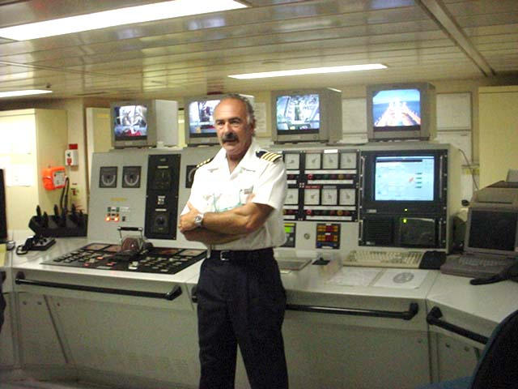
The ship’s engineer, who mans his station far below deck, provides the power.
Notes:
Think about the ship’s engineer who operates his station far below deck and provides the power that makes the propeller turn and power the boat.
His position is very much like the person talking and answering the questions.

Slide 4
The captain on the bridge determines the direction and the speed.
Notes:
While that is happening, the captain on the bridge determines the direction and the speed.
He is the person asking the questions to direct the conversation.

Slide 5
“We run this company on questions, not answers.”
Eric Schmidt,
CEO of Google
Notes:
Eric Schmidt was the man in charge of Google for ten years. He is quoted as saying…
That practice of asking questions applies to almost every aspect of leadership.

Slide 6
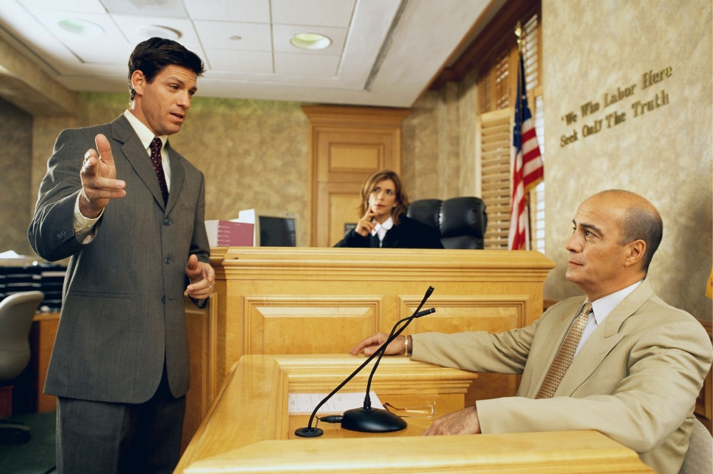
Notes:
Detectives in real life solve their mysteries by asking questions.
After solving the case, they turn everything over to the trial attorneys, who cannot introduce information directly.
They must enter the information before the judge and jury by asking questions of the witnesses.
They seldom ask a question that they don’t have a pretty good idea of what the answer will be.

Slide 7
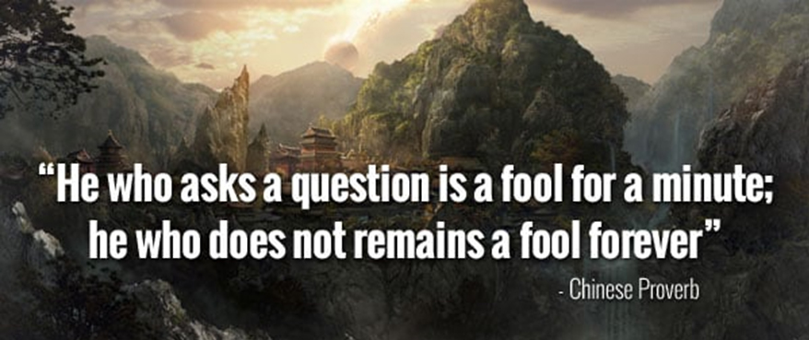
Notes:
Teenagers and others who think they already know everything don’t ask questions; why should they?
Asking questions is such a powerful way of gaining knowledge and understanding.
You have to wonder why so few people ask questions.
Some people are too lazy to listen, assuming they know everything they need.
They cling to their beliefs and remain confident in their assumptions because they often look foolish.
These people live by a fundamental belief or motto, ‘often in error but never in doubt.’
And some people are in such a hurry to get into action that they don’t stop to ask questions for fear that the questions and answers might slow them down at the risk of rushing headlong into the wrong steps.
They are anxious to put their tongue in gear before engaging their brain.
.

Slide 8
Closed-ended
Open-ended
Choice
Narrowing
Multiple Choice
Comparative
Confirming
Rhetorical
Notes:
Questions provide the speed and direction of the conversation.
There is more than one kind of question, each with a different advantage.
CLICK for following
Closed-ended
Open-ended
Choice
Narrowing
Multiple Choice
Comparative
Confirming
Rhetorical

Slide 9
Closed-End Questions
Notes:
Closed-ended questions can be answered with a single word or short sentence.
These are often considered weak questions but have great strength for directing or steering the conversation.

Slide 10
Open Ended Questions
Notes:
Unfortunately, it doesn’t work that way. Most of the time, open-ended questions are practical, but not all the time. When overused, they can make a conversation seem more like an interrogation and risk losing control of the conversation.
These questions start with who, what, why, when, and how.
“Who might be responsible for this calamity?”
“What happened next?”
“What business are we in? What is our added value?”
“Why didn’t you try something else?”
“Why do you think this has happened?”
“What factors will determine when we will be finished?”
“How did that happen?”

Slide 11
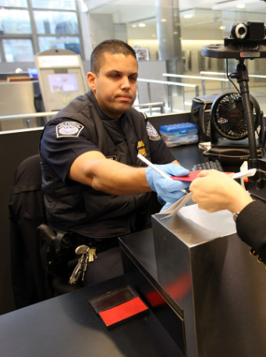
Who are you?
Where are you going?
What do you have to declare?
Notes:
If you were born in the USA, you won the life lottery and have given little thought to the following three questions.
If you were not born here, these three questions are the basics of what those immigration folks want to know before they let you into the country.
CLICK TO START
Who are you?
Where are you going?
What do you have to declare?
Those are good starting points for the questions people who lead and sell might want to ask.

Slide 12
“My greatest strength as a consultant is to be ignorant and ask a few questions.”
Peter Drucker
Professor and Consultant
Notes:
Open-ended questions are often reported to be the most valuable and powerful.
These are the question that solicits open dialogue, which needs to be more quickly answered with a single word or short sentence.
Open-ended questions are believed to get the person talking, solicit information, and allow those involved to find out if there is a mutual opportunity.

Slide 13
Confirming Questions
What you are saying is?
Notes:
A specific kind of closed-ended question would be one asked to confirm what you think the other person is saying, or it can simply be a form of reinforcement.
It can be a reflection of what is said, or it can be rewarding feedback. Example: “What you are saying is?” shows you listening.
Asking many questions is highly effective but can make you appear inquisitorial and intrusive.

Slide 14
Compare and Contrast Questions
Notes:
A type of choice question would compare several options and then contrast that with another set of options.

Slide 15
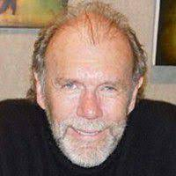
“You don't want a million answers as much as you want a few forever questions. The questions are diamonds you hold in the light. Study a lifetime and you see different colors from the same jewel. The same questions, asked again, bring you just the answers you need just the minute you need them.”
Richard Bach
American writer Jonathan Livingston Seagull
Notes:
Richard Bach, who wrote Jonathan Livingston Seagull
This exercise can spur critical thinking beyond mere description or summary to generate interesting analysis.
When you reflect on similarities and differences, you gain a deeper understanding of the items you are comparing, their relationship to each other, and what is most important about them.

Slide 16
Compare and Contrast Questions
Notes:
A type of choice question would compare several options and then contrast that with another set of options.
This exercise can spur critical thinking beyond mere description or summary to generate interesting analysis.
When you reflect on similarities and differences, you gain a deeper understanding of the items you are comparing, their relationship to each other, and what is most important about them.

Slide 17
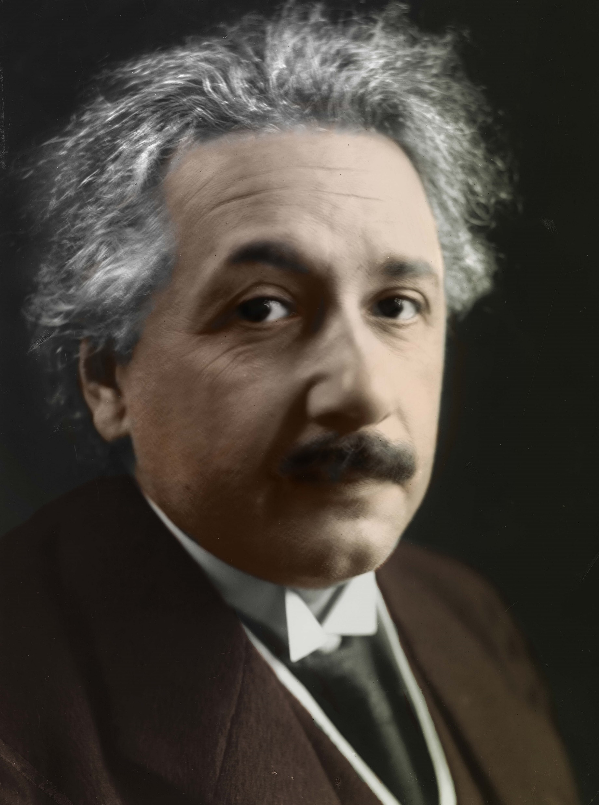
“To raise new questions, new possibilities, to regard old problems from a new angle, require creative imagination and marks real advance in science.”
Albert Einstein
Notes:
No less than the reputed genius Albert Einstein said.
In science, asking questions is the basis of the scientific method.
Someone puts forward an idea they call a hypothesis, and everyone else asks questions ad tries to prove the theory wrong.
It takes a thick skin to put forward an idea and endure all the challenges.

Slide 18
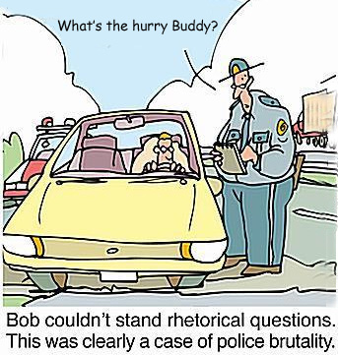
Rhetorical Questions
Notes:
A rhetorical question is an inquiry that ends in a question mark but is asked for effect rather than to elicit an answer.
It’s often used in persuasive writing but is common in everyday conversation.
Here are a few of my favorite rhetorical questions.
Why do you need a driver’s license to buy liquor when you can’t drive and drink?
Why isn’t phonetic spelling - spelled the way it sounds?
Why are there interstate highways in Hawaii?
How does the guy who drives the snowplow get to work in the mornings?
Why is it when you transport something by car it’s called a shipment, but when you transport by ship it is called cargo?

Slide 19
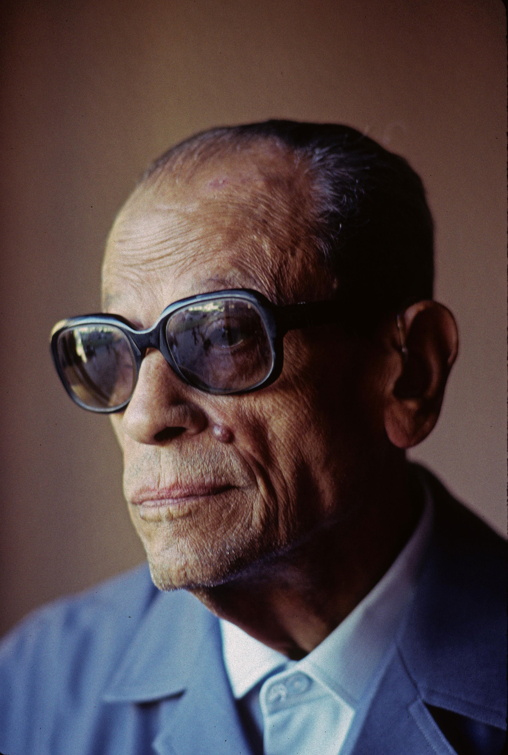
“You can tell whether a man is clever by his answers. You can tell whether a man is wise by his questions.”
Naguib Mahfouz
Egyptian Writer and Nobel Laureate
Notes:
Some questions require a response that may have a significant impact.
These are the questions that get right to the primary motivation for action.
A few examples of this kind of questions would be:
What happens if this problem is not dealt with now?
What are the long-term ramifications of the current situation?
How long until the current trend line ends in disaster if extended to its conclusion?
These questions create a sense of urgency by bringing the ultimate impact of action or inaction into clear focus. If the series of questions that lead to an impact question is sufficient, the impact question will result in a severe motivation to take some action.

Slide 20
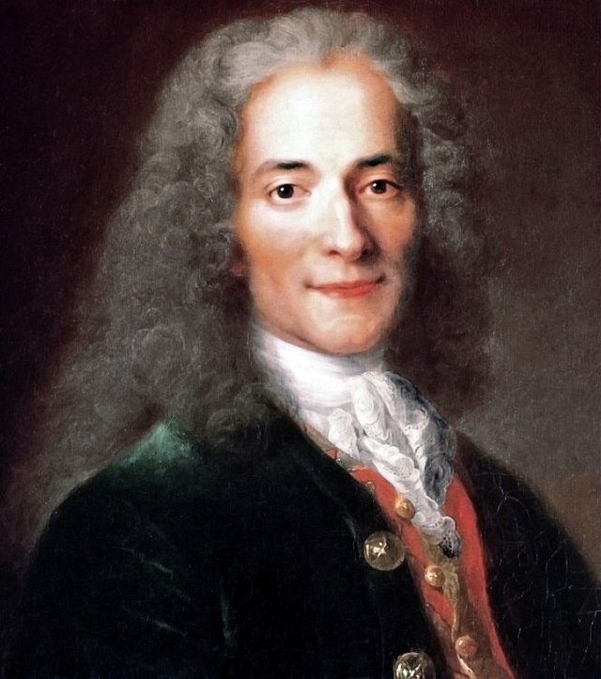
“Judge a man by his questions rather than his answers.”
Voltaire
Notes:
In the words of the writer and philosopher Voltaire, “Judge a man by his questions rather than his answers.”
That concept applies to almost every aspect of leadership.
A failure to listen and ask questions leaves the people who will follow you wondering if you know where you are leading them.
They would think you are a charlatan. Take the time to do the right thing.

Slide 21
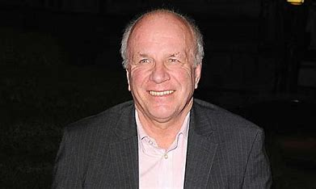
Greg Dyke
Director-General of the British Broadcasting Corporation
“What is the one thing I should do to make things better for you?”
“What is the one thing I should do to make things better for our viewers and listeners?”
Notes:
I am inspired by the story of a fellow named Greg Dyke, who became the Director-General of the British Broadcasting Corporation (BBC) in 2000.
At the top of his agenda was visiting every central BBC installation in the world, where he asked these questions,
CLICK FOR VOICE OVER
and then he listened and followed with another question.
He knew that he would learn more from his employees at that early stage than they could from him.
The workers at the BBC had many beautiful ideas that they were keen to share and were very impressed that the new boss took the time to ask questions and listen.

Slide 22
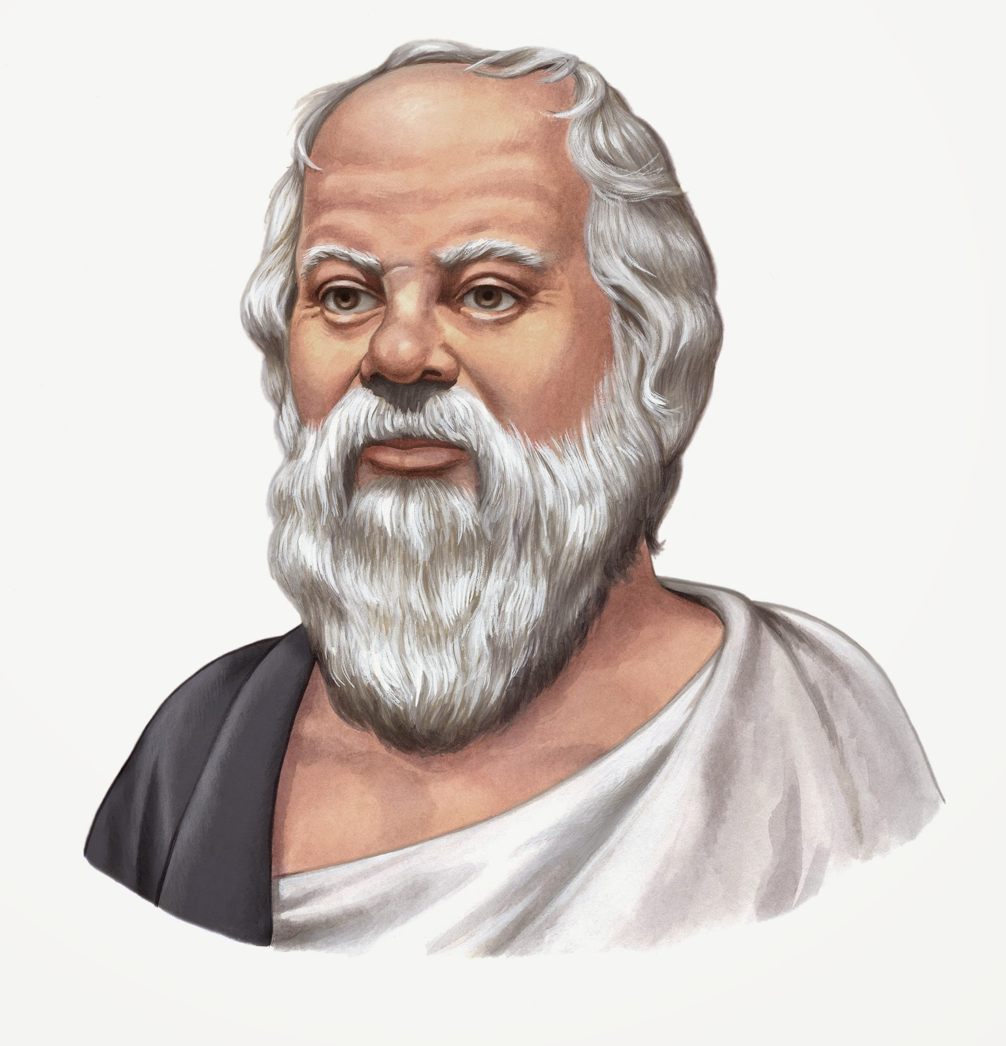
“True wisdom comes to each of us when we realize how little we understand about life, ourselves, and the world around us.”.
Socrates
Notes:
A few thousand years ago, there lived a fellow named Socrates, who, in the words of a fourth grader, "lived a long time ago and gave people good advice and in appreciation they made him drink hemlock.“
I didn’t hear it myself, but Socrates reportedly said it.
He is widely viewed as one of the founders of Western philosophy and is primarily known through the accounts of his student Plato. His most significant contribution to Western thought is his systematic process of inquiry, known as the Socratic method, which he applied to examine vital moral concepts such as soundness and justice.
Plato first described it in the Socratic Dialogues. To solve a problem,
it would be broken down into a series of questions, the answers to which gradually distill the answer a person would seek.
To illustrate the use of the Socratic method, questions are posed to help a person or group determine their underlying beliefs and the extent of their knowledge. The Socratic method is a harmful method of hypothesis elimination in that better hypotheses are found by steadily identifying and eliminating those that lead to contradictions. It was designed to force one to examine one's beliefs and the validity of such ideas. Socrates once said, “I know you won’t believe me, but the highest form of Human Excellence is to question oneself and others.”
Socrates led his students and the greater public to realize the truths he could see by asking questions.
He sold his ideas by making his listeners think they were, in fact, their ideas.

Slide 23
Notes:
Not asking questions is like having a high-powered rifle and shooting without aiming.
That would be ridiculous, almost as ridiculous as prescription without diagnosis is malpractice, no matter the context.
And that would be just as ridiculous as the leaders who don’t take the time or try to find out where their followers want to go.
They need to identify what will motivate others.

Slide 24
Notes:
It is very much like a pilot’s flight plan. Good pilots live to old age precisely by following their preflight checklist and filing a flight plan. They also know that as soon as the wheels leave the ground, weather and other planes will force them to adjust their flight plan.
The time spent thinking about and creating a game plan will pay future dividends in conversation after conversation.

Slide 25
“A boss creates fear, a leader confidence. A boss fixes blame; a leader corrects mistakes.
A boss knows all; a leader asks questions. A boss makes work drudgery; a leader makes it interesting.”
Russell H Ewing
British Journalist
Notes:
The most important questions you ask concern aspirations, dreams, and goals.
The answers you need concern the satisfaction and fulfillment of doing something today that might lead to long-term fulfillment of those aspirations, dreams, and goals.
Brilliant thinkers never stop asking questions because they know that is the best way to gain deeper insights.
Great leaders because they know nobody cares how much you know; until they know how much you care.
Asking questions and listening to the answers demonstrate that you care.
A failure to listen and ask questions leaves the people who will follow you wondering if you know where you are leading them.
They would think you are a charlatan.

Slide 26
Notes:
The skill of active listening is essential to being a good leader.
The skill of asking good questions is what leverages listening into being one of the most powerful leadership skills.
Here is an idea of a topic many Rotarians could present to our RYLA participants.
A PowerPoint is available to make it easy to do.
I am Steve Garrett; thank you for indulging me with some of your time.

