Slide 1
Creating Trust
Leadership Skill
Notes:
The creation of trust must be an explicit goal of leaders.
Building trust often results from demonstrating competence and capability and must be an essential strategy.
TRUST is the greatest missing competency of leadership today.

Slide 2
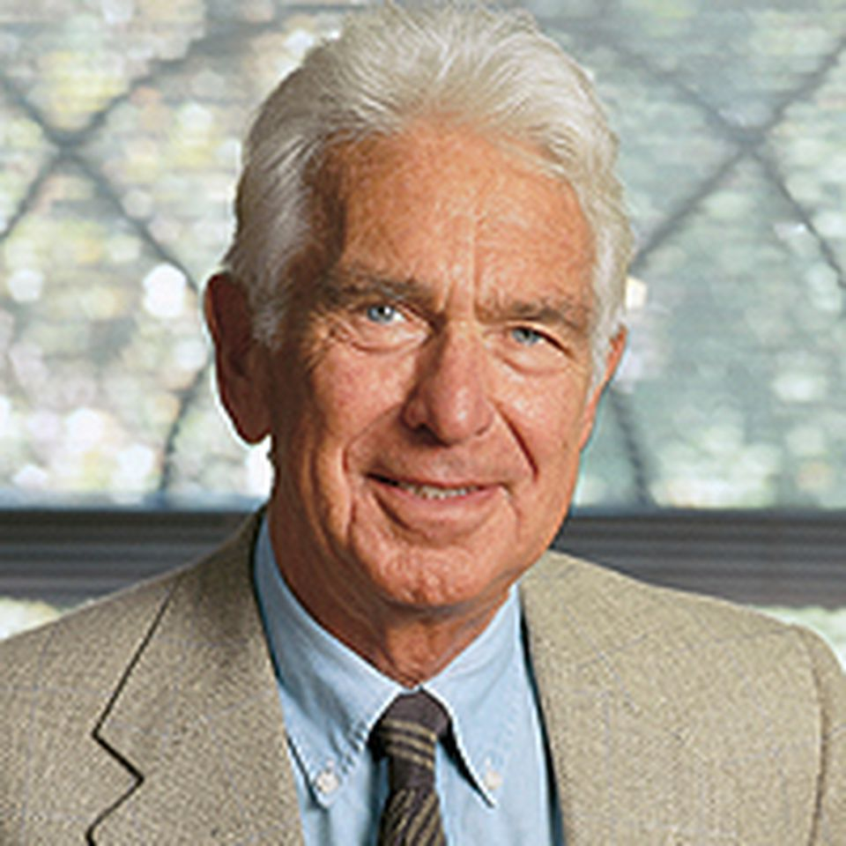
"Leadership without mutual trust is a contradiction in terms."
Warren Bennis
Professor, Consultant, and Author
University of Southern California
Notes:
The creation of trust must be an explicit goal of leaders.
Building trust often results from demonstrating competence and capability and must be an essential strategy.
Falsely representing competence and capability that doesn’t exist violates trust.
This vital principle requires self-awareness of what limitations you should place on your competence and ability.

Slide 3
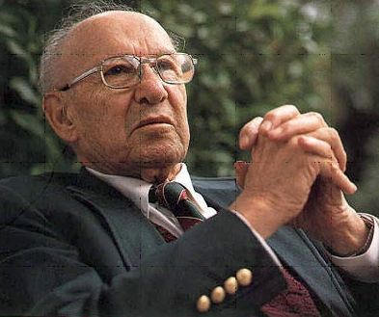
“Leadership is an achievement of trust.”
Peter Drucker
Write and Management Consultant
Notes:
The only definition of a leader is someone with followers.
When you do it, do it your way, what works for you.
Do not try to be anybody else. Leadership is an achievement of trust.
You know what to expect, and you see performance and achievement.
High-trust organizations outperform low-trust organizations by a factor of three.

Slide 4
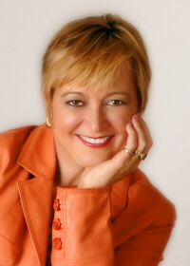
People Do Business With People They Know, Like, And Trust.
Rachelle Disbennett-Lee, PhD
Business coach
Notes:
The most important activity in building trust is building relationships.
People are attracted to working for, working with, and following leaders they trust.
Do you believe you are worthy of being trusted?
Do you believe you can open yourself up to others?

Slide 5
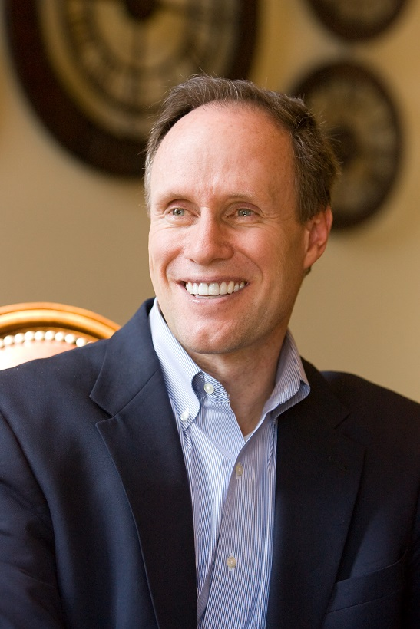
“Nothing is as fast as the speed of trust. It’s the one thing that changes everything.”
Stephen M. R. Covey
Writer and Public Speaker
Notes:
There is an economic case
There is economic value in having trust.
Trust is the accelerator that makes good results happen faster

Slide 6
Notes:
Trust impacts two outcomes: cost and speed. Speed is a cost.
Increasing trust makes things go faster.
Where there is high trust, speed, and costs go down.

Slide 7
Notes:
High Trust makes for lower costs, and lower cost manifest themselves in higher profits.
HIGHER profits are the goal in both for-profit organizations where progress is measured in economic benefits
And not-for-profit organizations where progress is measured in accomplishing strategic initiatives.
That is the Trust Dividend.

Slide 8
Notes:
When Trust goes down
Energy goes down, innovation collaboration go down
The joy of accomplishment goes way down.

Slide 9
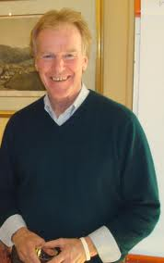
“Real learning gets to the heart of what it means to be human. Through learning, we re-create ourselves. Through learning, we can do something we never were able to do. Through learning, we reperceive the world and our relationship to it. Through learning, we extend our capacity to create, and to be part of the generative process of life. Each of us has a deep hunger for this type of learning.”
“
Peter M. Senge
Art and Practice of the Learning Organization
Notes:
The important idea is that Trust is a learnable competence.
You can learn the skills and strategies to earn, nurture and retain trust.

Slide 10
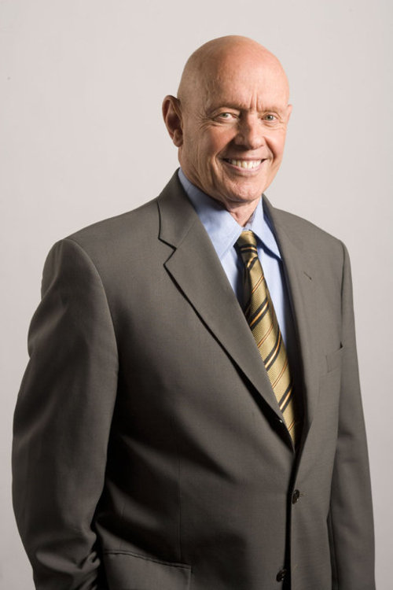
“When you trust people, you have confidence in them — in their integrity and in their abilities.”
Stephen R. Covey 7 Habits of Highly Effective People
Notes:
Start by extending Trust in others.
Trust requires two people, as Covey said, but “you can go first.”
This doesn’t mean being gullible or what Covey calls “blind trust.”
Obviously, you need to use your senses and wits. And perhaps your gift of trust is deeper with someone you know well than with a stranger.
But consider being generous — after all, there is no such thing as engagement at arms’ length.

Slide 11
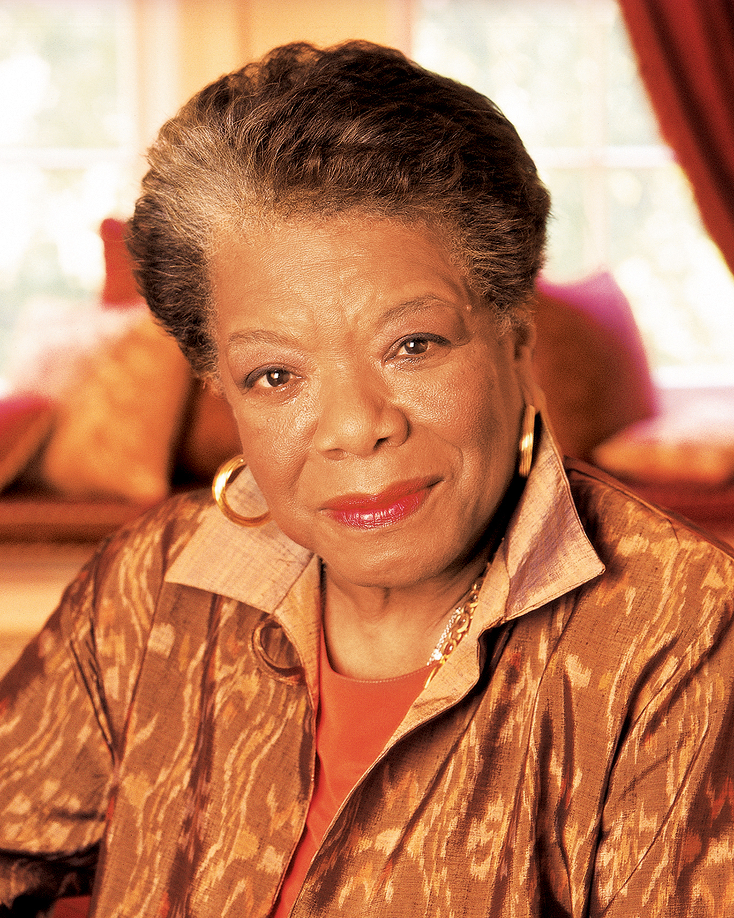
“I’ve learned that people will forget what you said, people will forget what you did, but people will never forget how you made them feel.”
Maya Angelou
Poet, Memoirist, and Activist
Notes:
Being a credible leader requires actions that are louder than your words.
Invest in building trust by behaving your way to credibility.

Slide 12
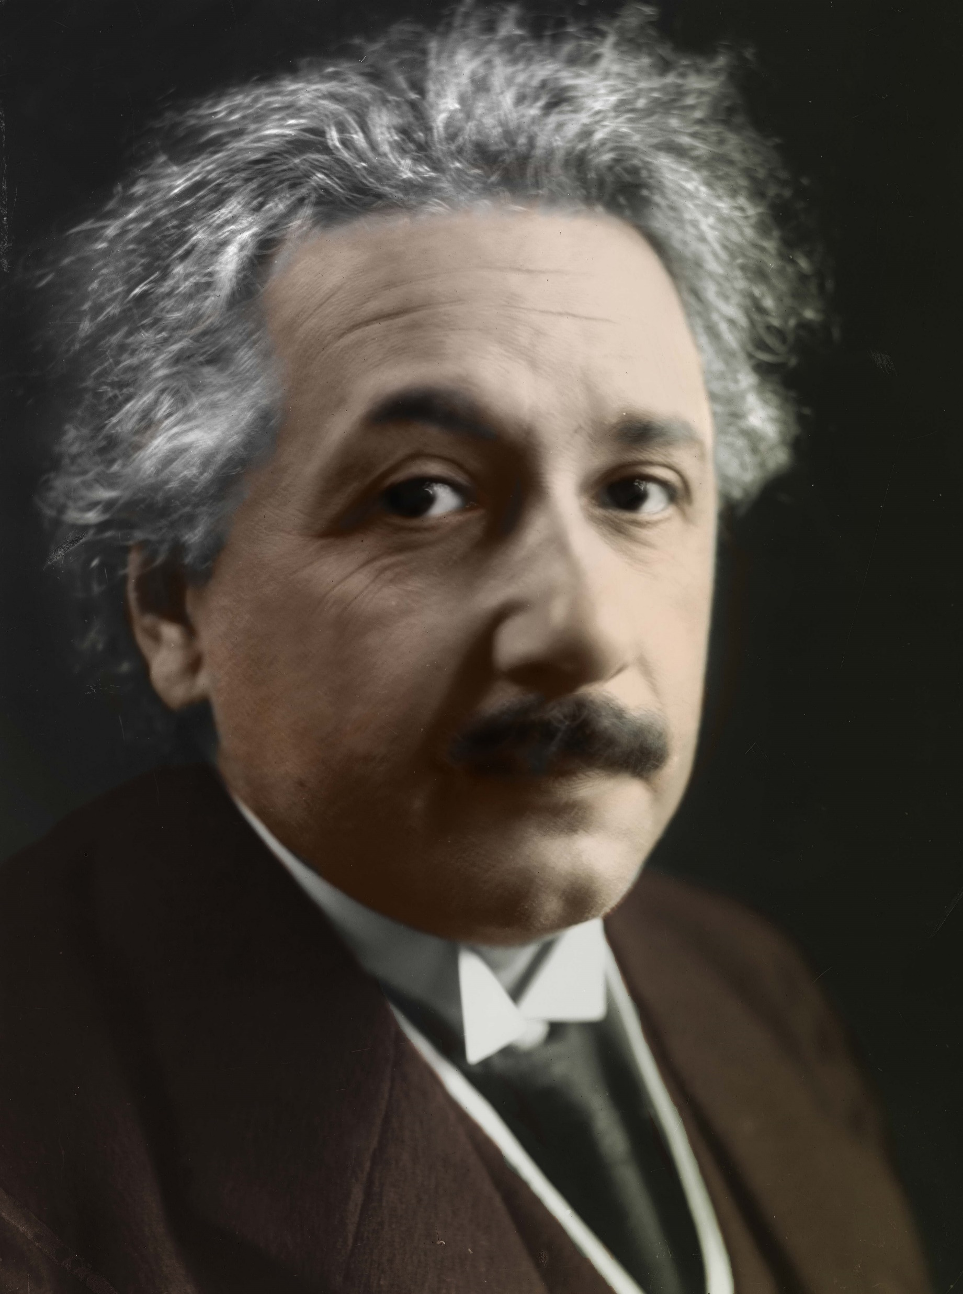
“Whoever is careless with the truth in small matters cannot be trusted with important matters.”
Albert Einstein Mathematician and Physicist
Notes:
Trust in the process. As I am fond of saying, leading and managing is a never-ending task. You cannot perfect trust or leadership, nor can you rush them. But leaders have to model and encourage the giving, reciprocating and earning of trust if they want the culture to adopt the mindset and put it into practice. It was fitting that the event began with “trust” and ended with “execution.” The two are intertwined more deeply than most of us realize. As Ted Bauer recent wrote, “Ludicrous how often we discuss ‘trust’ and ‘reputation’ in business journalism and yet, it barely matters to many managers at the execution level. If it did, we’d have more ability to work independently and see problems through. We don’t, though.”

Slide 13
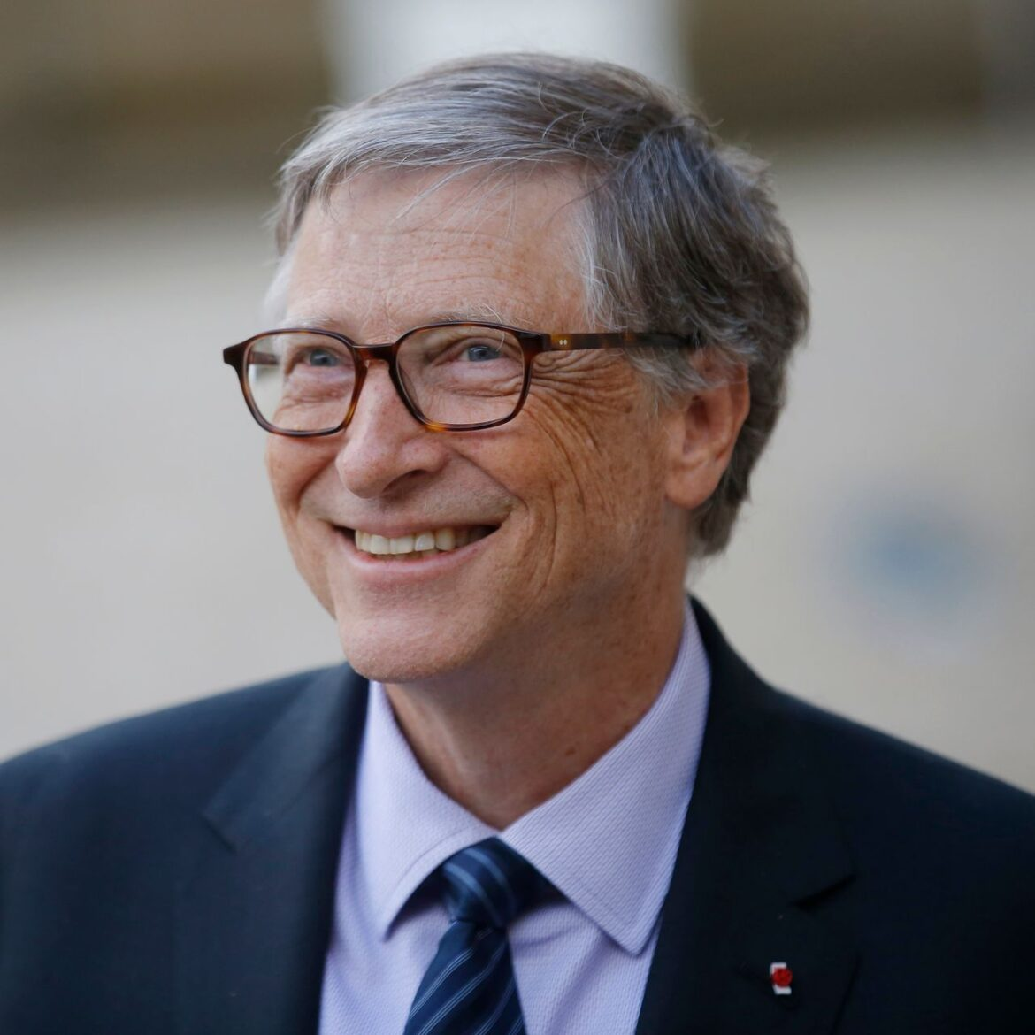
“Once you embrace unpleasant news not as negative but as evidence of a need for change, you aren't defeated by it. You're learning from it.”
Bill Gates
Business leader, Philanthropist
Notes:
When was the last time you requested feedback from individual team members?
Was the feedback authentic?
Have you made it easy for people to tell the truth?
If you’re not receiving regular feedback, including voluntary feedback, your people may not feel safe telling you the truth.
Trusted leaders’ team members are willingly transparent because they know telling the truth won’t lead to reprisals.

Slide 14
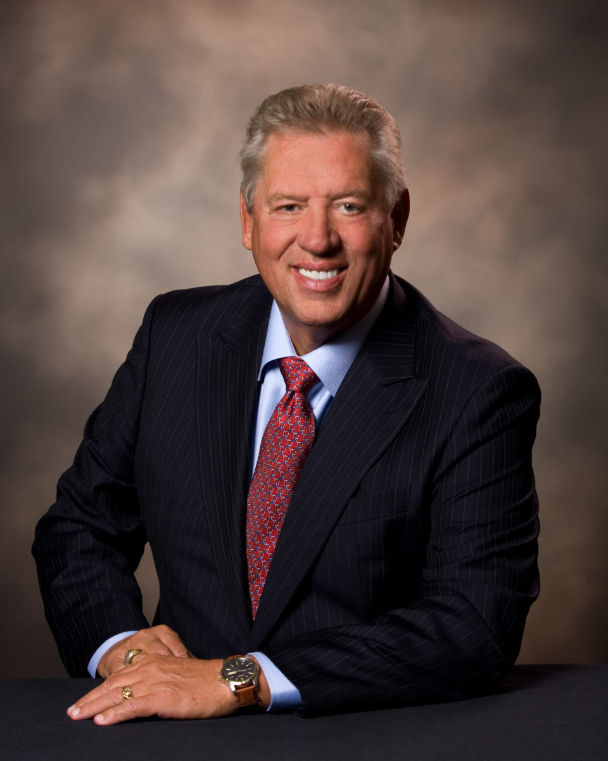
Leadership is taking responsibility while others are making excuses.”
John C. Maxwell
Author, Speaker, and Pastor
Notes:
Admitting you made a mistake demonstrates essential leadership skills, high self-esteem, confidence, and the need for growth.
Do you respond or react when you make mistakes or disappoint team members?
While your first instinct may be to excuse yourself or dismiss the wrong as inconsequential, righting wrongs builds trust.
Dismissing them erodes trust. Challenge yourself to right wrongs.
“That’s my mistake.”
You may feel like crawling under a rock when you make a mistake. But admitting it out loud shows courage integrity, and that you recognize the impact of what you did and are willing to accept responsibility. It also models to your team that owning up to errors is okay— even desirable—which can help your team feel more open to trying new ways of doing things.
Inevitably, we all make mistakes. We’re human.

Slide 15
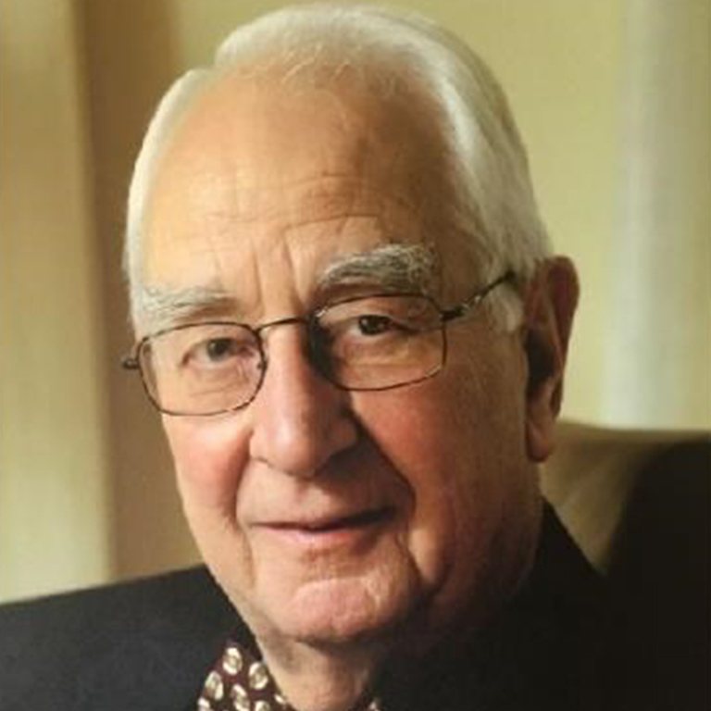
“The first responsibility of a leader is to define reality. The last is to say thank you. In between, the leader is a servant.”
Max De Pree
Author Leadership is an Art
CEO Herman Miller Office Furniture
Notes:
When was the last time you technically told the truth, but left a misleading impression?
To talk straight means communicating clearly and explicitly, eliminating all possible misunderstandings.
It’s a behavior that does not go unnoticed by team members and one they crave. Challenge yourself to talk straight.

Slide 16
A Short Course in HUMAN RELATIONS
The SIX Most Important Words:
"I admit I made a mistake."
The FIVE Most Important Words:
"You did a good job."
The FOUR Most Important Words:
"What is your opinion."
The THREE Most Important Words:
"If you please."
The TWO Most Important Words:
"Thank you"
The ONE Most Important Word:
"We "
The LEAST Important Word:
“I”
Notes:
Asking followers for their opinions and ideas is one of the most potent ways to tell them, “I value what you think.” Those we lead and motivate often have innovative solutions to problems but lack the confidence to make suggestions.
Asking “would you please” instead of commanding and directing will achieve a better outcome in most interactions with people.
Saying “thank you” acknowledges a person’s contributions or gifts. All of us like to be thanked for what we do.
Get into the habit of saying “we” instead of “I,” and you will often find a supportive team behind you. Leaders who ask employees to share their opinions and provide input into the decision-making process strengthen their leadership position. Most importantly, leaders who “share the glory” and accept thanks on behalf of their team, not personally, increase the morale and commitment of their team.

Slide 17
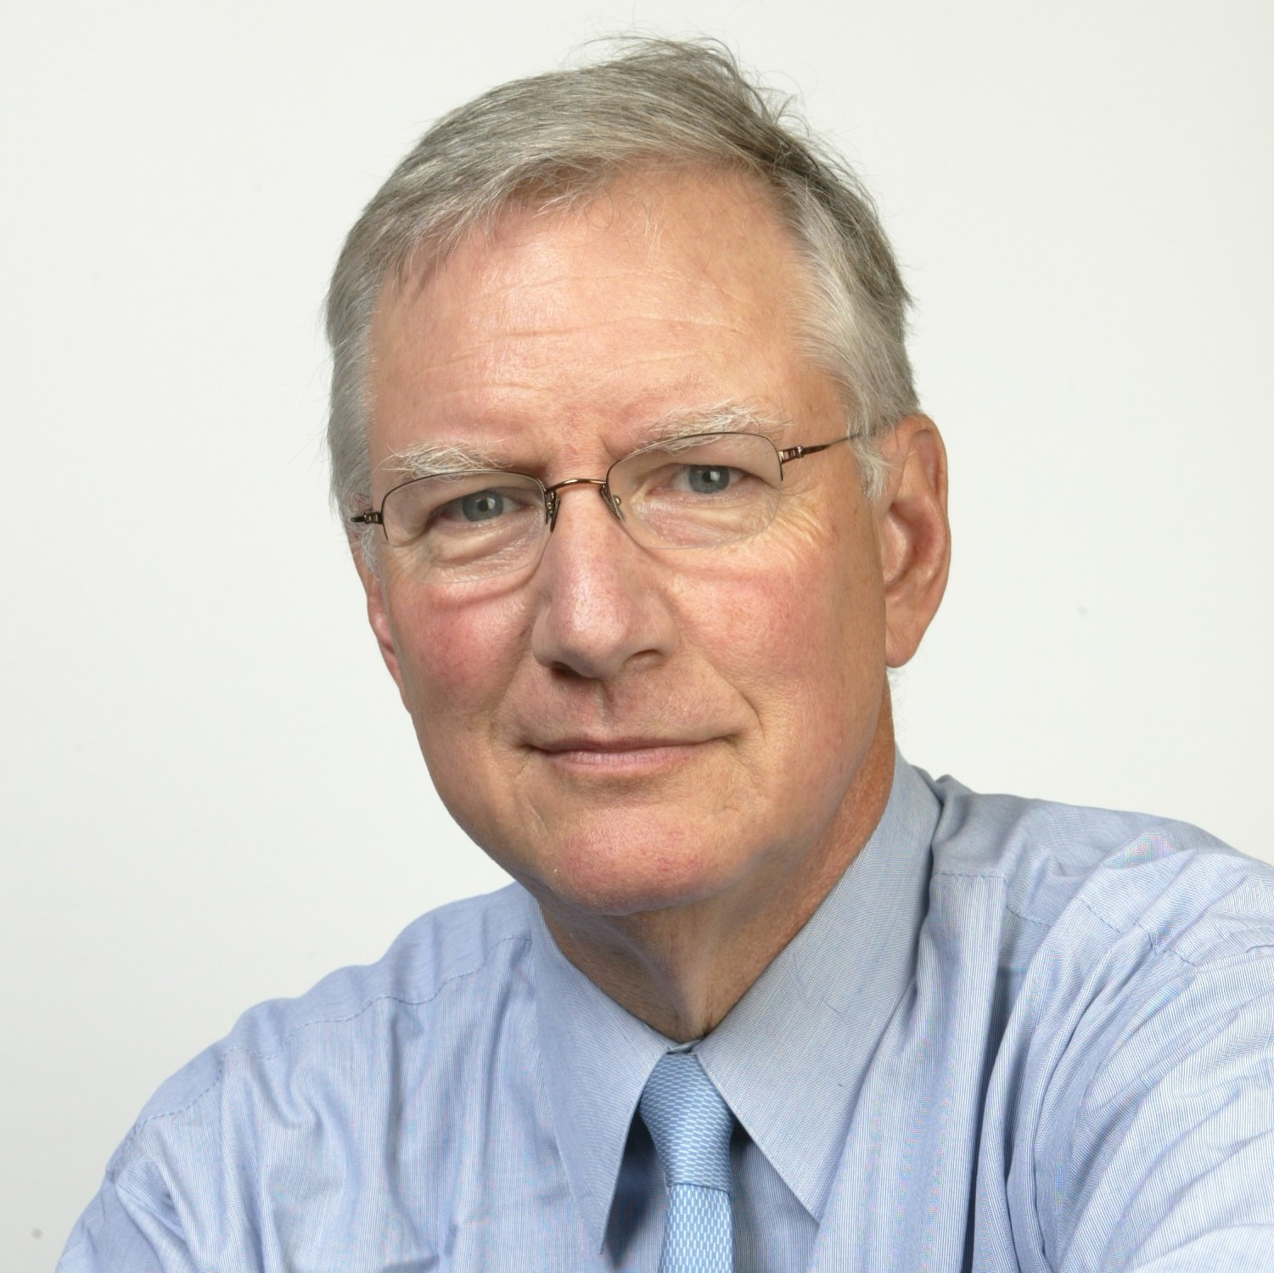
“Formula for success: under promise and over deliver.”
Tom Peters
Famed Management Consultant
Notes:
Under-promise, and over-deliver means setting reasonable expectations and knocking them out of the park. The saying has become a mantra for delighting customers — these promises arise from split-second decisions when communicating directly with customers.

Slide 18
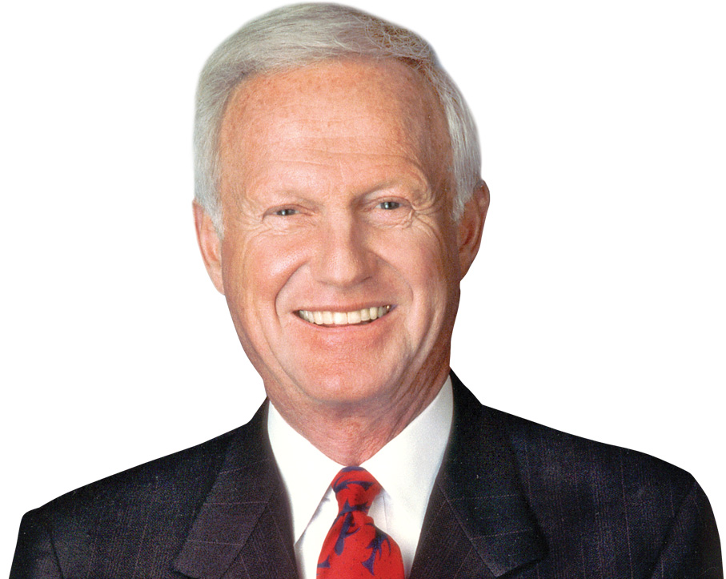
"You learn when you listen. You earn when you listen; not just money, but respect."
Harvey Mackay
Author and Motivational Speaker
Notes:
Genuinely understand another person's thoughts and feelings, before trying to diagnose or advise. The opposite and counterfeit are to speak first and listen last, or not at all, and to pretend to listen while waiting for your own chance to speak. Listening teaches you which behaviors create dividends. Use your eyes and your gut to listen as well as your ears, and don't presume you know what matters to others.
The old axiom that nobody cares how much you know; until they know how much you care makes as much sense today as it ever did. You earn respect from others for your thoughts and opinions by showing interest and concern for their views.

Slide 19
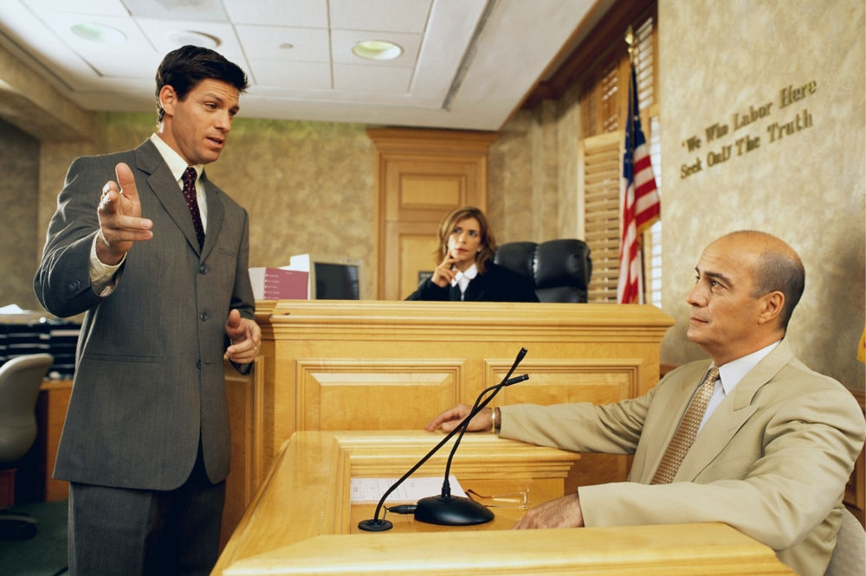
Notes:
A defense attorney was cross-examining a police officer during a felony trial. It went like this: Q: Officer, did you see my client fleeing the scene? A: No sir, but I subsequently observed a person matching the description of the offender running several blocks away. Q: Officer, who provided this description? A: The officer who responded to the scene. Q: A fellow officer provided the description of this so-called offender. Do you trust your fellow officers? A: Yes sir, with my life. Q: With your life? Let me ask you this then officer -- do you have a locker room in the police station -- a room where you change your clothes in preparation for your daily duties? A: Yes sir, we do. Q: And do you have a locker in that room? A: Yes sir, I do. Q: And do you have a lock on your locker? A: Yes sir. Q: Now why is it, officer, if you trust your fellow officers with your life, that you find it necessary to lock your locker in a room you share with those officers? A: You see sir, we share the building with a court complex, and sometimes defense attorneys have been known to walk through that room.

Slide 20
You can’t talk your way out of something you behaved your way into. You have to behave your way out of it.
— Doug Conant

